Slide 1
Lecture 24: Review

Slide 2
Uncertainty in model and prediction
Cross validation
Overfitting: Variance & Bias
Pandas
NumPy
Scikit-Learn
PCA & dimensionality reduction
Statistical Learning
Computing Tools
Matplotlib
Methods of regularization:
Lasso and Ridge
Regression
Classification
Logistic
Linear
Trees
KNN
Neural Networks
Experimental Design & Causal Inference

Slide 3
Uncertainty in model and prediction
Cross validation
Overfitting: Variance & Bias
Pandas
NumPy
Scikit-Learn
PCA & dimensionality reduction
Statistical Learning
Computing Tools
Matplotlib
Methods of regularization:
Lasso and Ridge
Regression
Classification
Logistic
Linear
Trees
KNN
Neural Networks
Experimental Design & Causal Inference

Slide 4
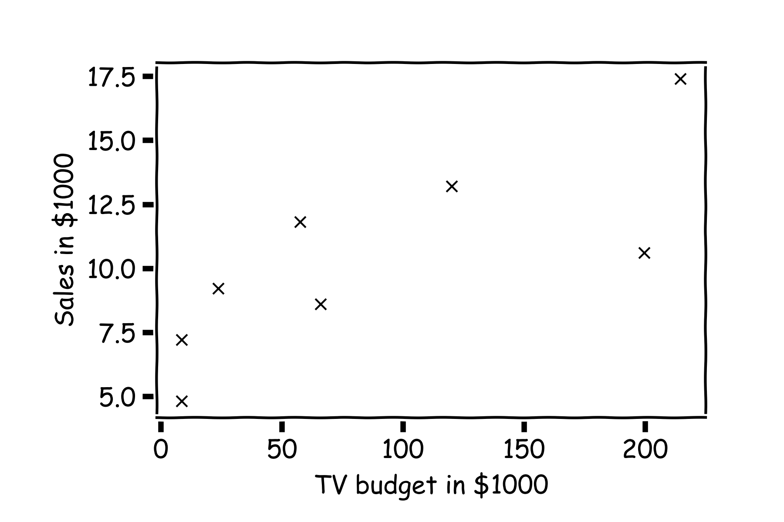
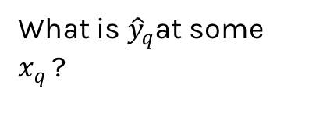
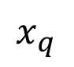
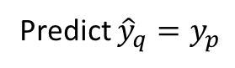
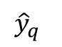
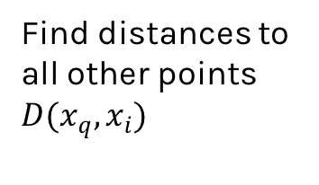
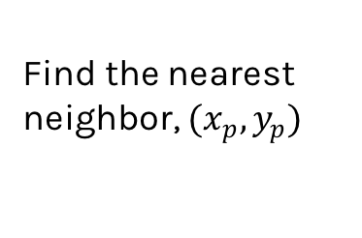
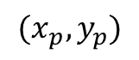
Simple Prediction Model
What is ${\hat{y}}_{q}$at some $x_{q }$?
Find distances to all other points $D(x_{q},x_{i})$
$${(x}_{p},y_{p})$$
$${\hat{y}}_{q}$$
Find the nearest neighbor, ${(x}_{p},y_{p})$
Predict ${\hat{y}}_{q}=y_{p}$
$$x_{q}$$
Notes:
Is it clear that x_q is really x_i,q? (DLS)

Slide 5
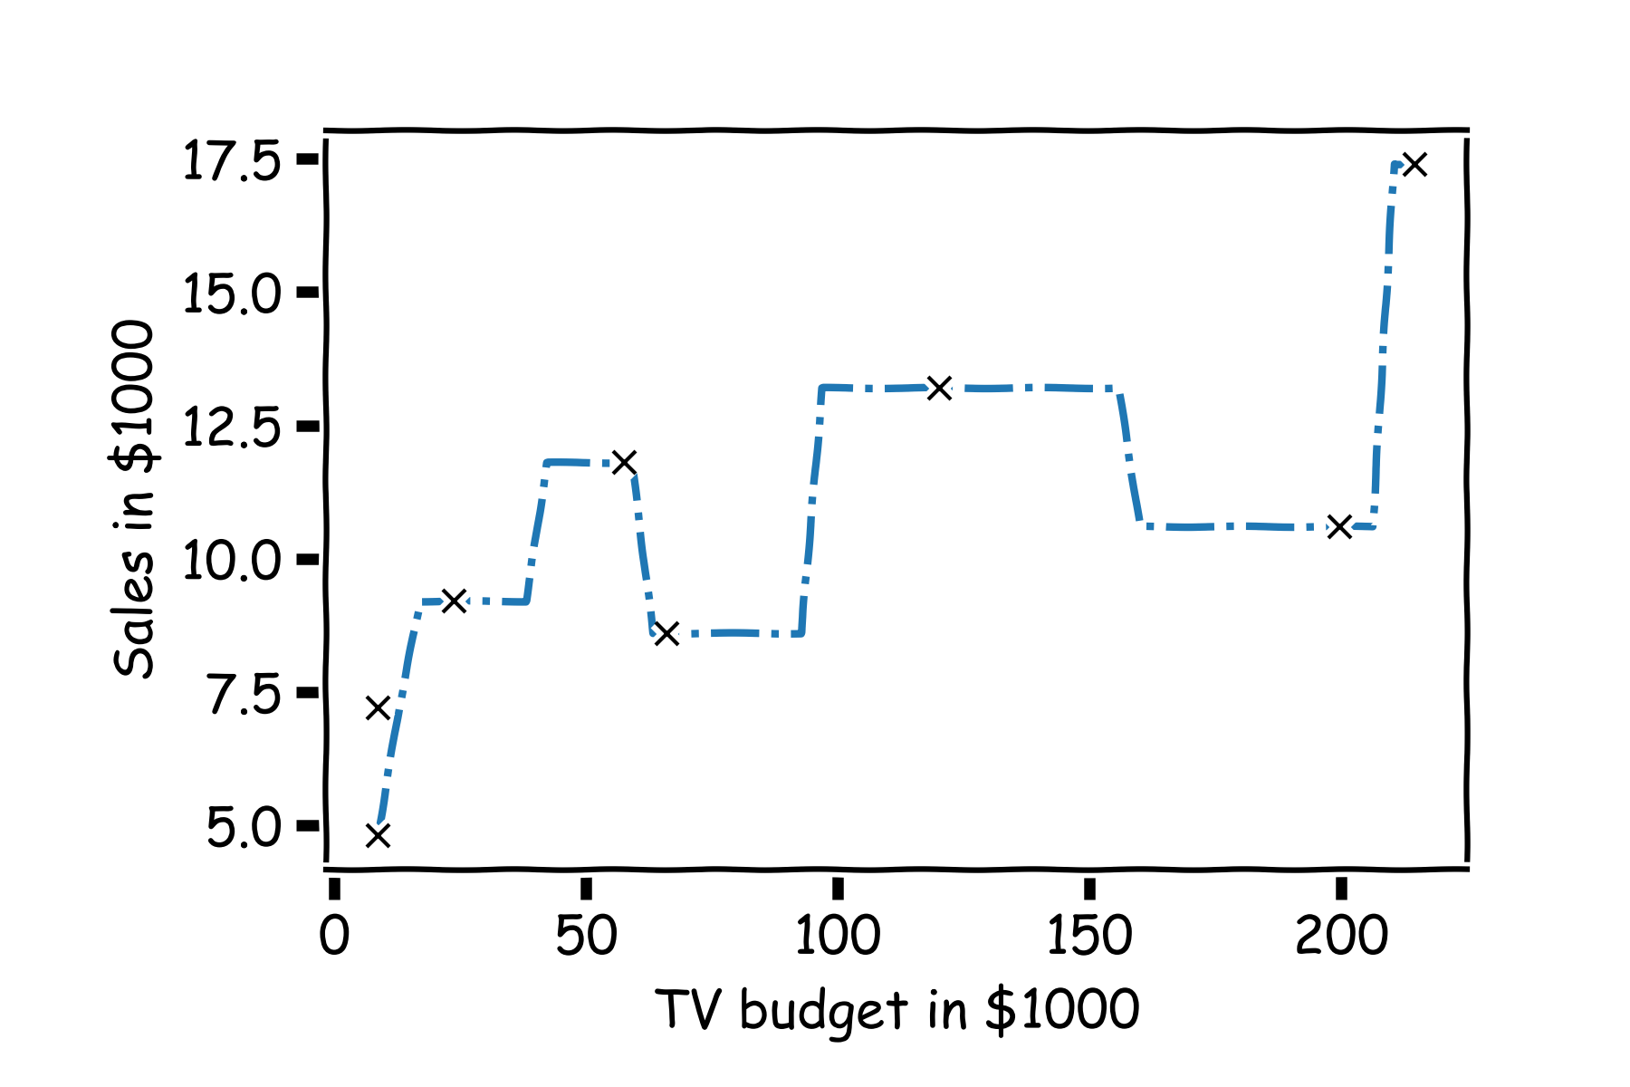
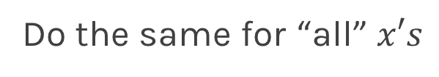
Simple Prediction Model
Do the same for “all” $x′s$

Slide 6
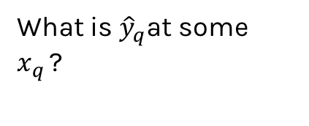
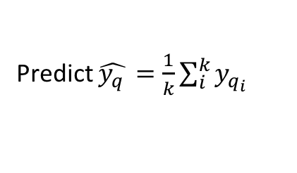
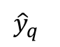
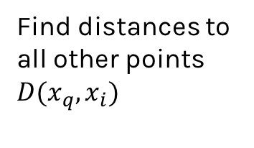
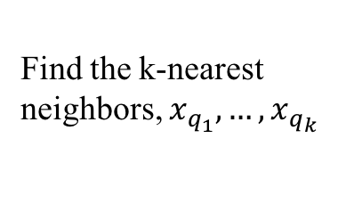
Extend the Prediction Model
What is ${\hat{y}}_{q}$at some $x_{q }$?
Find distances to all other points $D(x_{q},x_{i})$
$${\hat{y}}_{q}$$
Find the k-nearest neighbors, $x_{q_{1}},…,x_{q_{k}}$
Predict $\hat{y_{q }}=\frac{1}{k}\sum_{i}^{k}{y_{q_{i}}}$
$$x_{q}$$
Notes:
Change indeces and show k-nearest

Slide 7
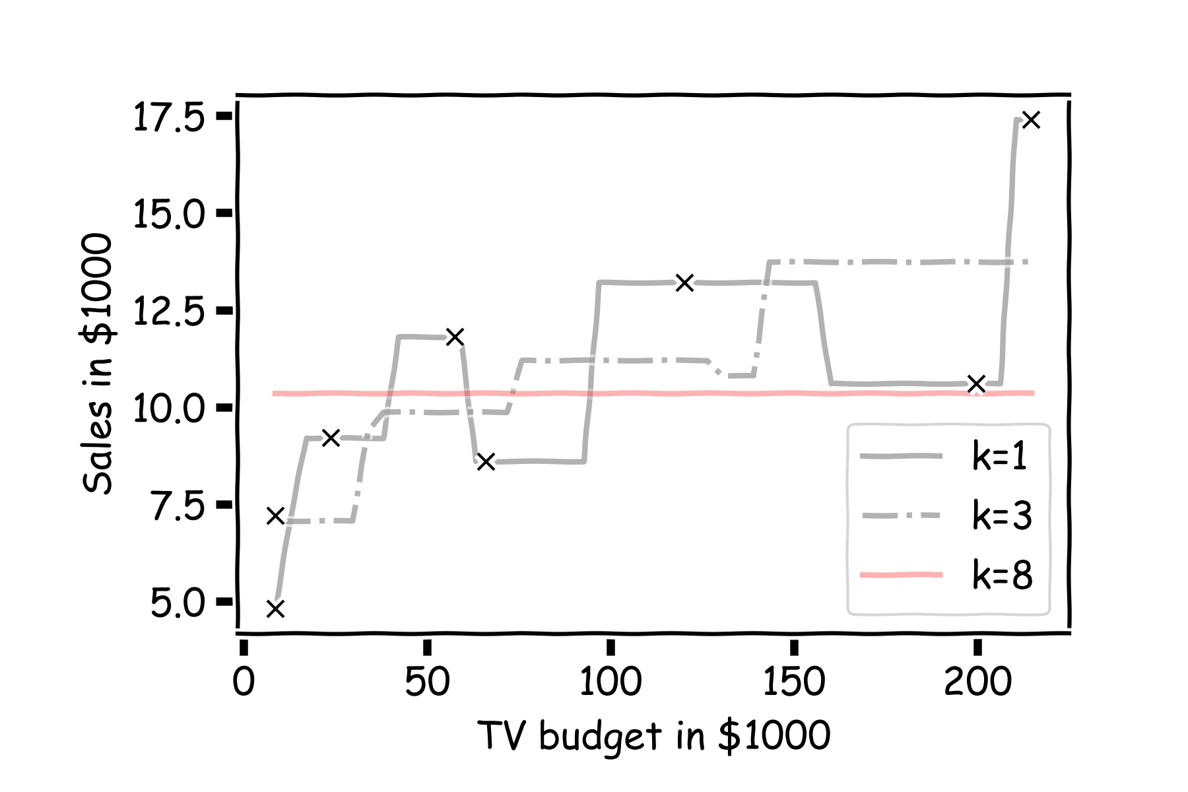
Simple Prediction Models
Notes:
Change indeces and show k-nearest

Slide 8

Simple Prediction Models
We can try different k-models on more data
Notes:
Change indeces and show k-nearest

Slide 9
Uncertainty in model and prediction
Cross validation
Overfitting: Variance & Bias
Pandas
NumPy
Scikit-Learn
PCA & dimensionality reduction
Statistical Learning
Computing Tools
Matplotlib
Methods of regularization:
Lasso and Ridge
Regression
Classification
Logistic
Linear
Trees
KNN
Neural Networks
Experimental Design & Causal Inference

Slide 10
Uncertainty in model and prediction
Cross validation
Overfitting: Variance & Bias
Pandas
NumPy
Scikit-Learn
PCA & dimensionality reduction
Statistical Learning
Computing Tools
Matplotlib
Methods of regularization:
Lasso and Ridge
Regression
Classification
Logistic
Linear
Trees
KNN
Neural Networks
Experimental Design & Causal Inference

Slide 11
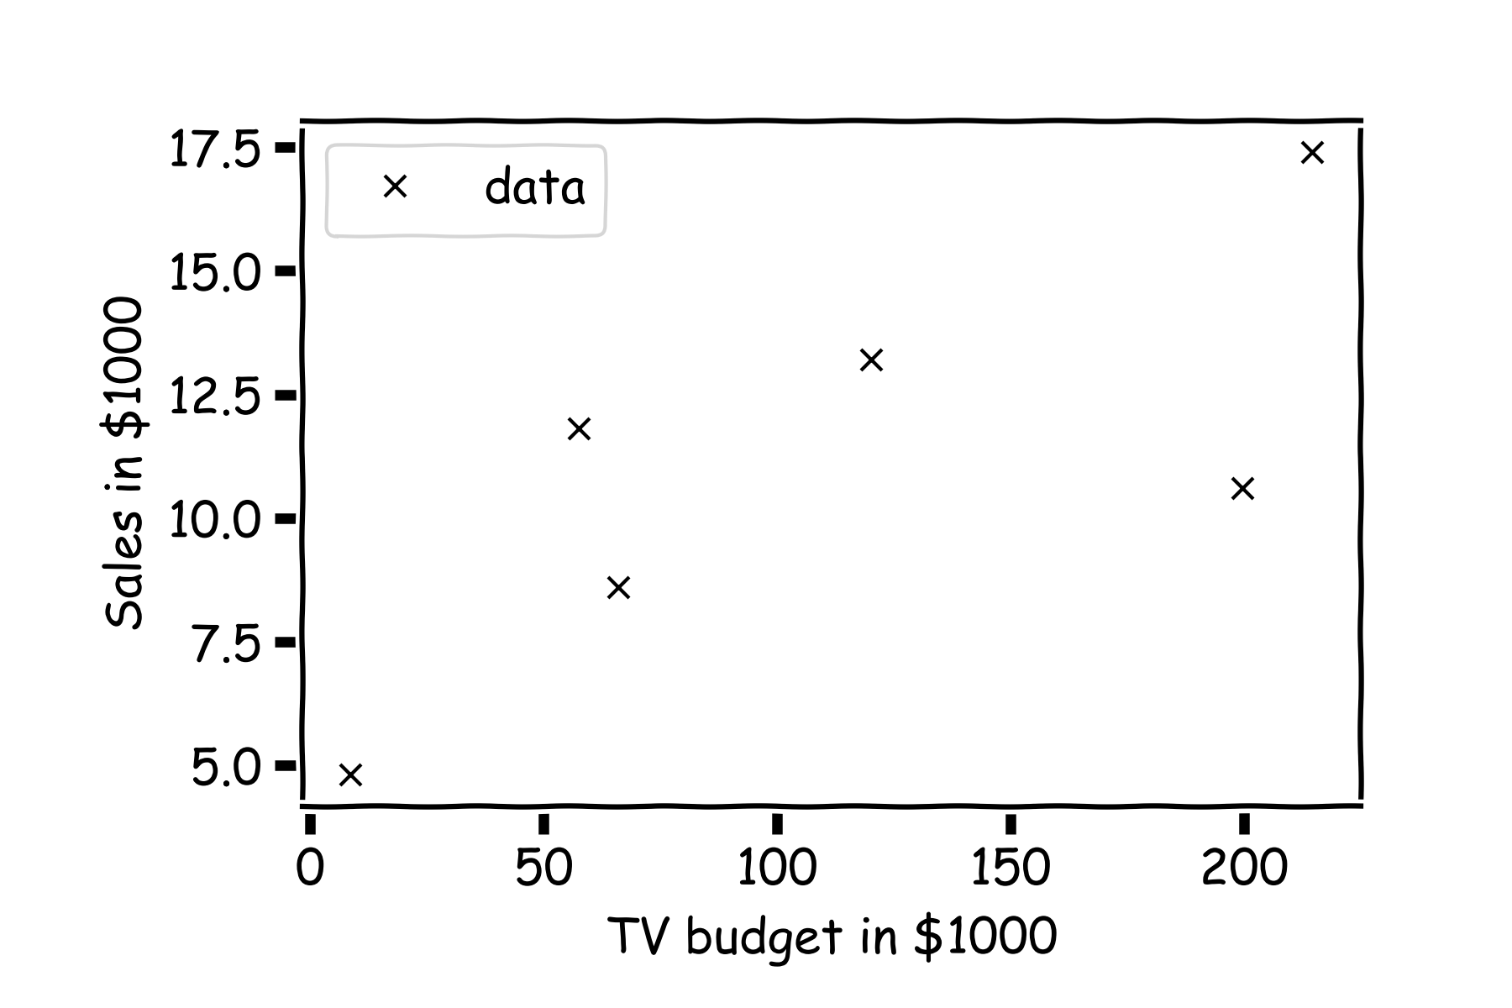
Estimate of the regression coefficients
For a given data set

Slide 12
Estimate of the regression coefficients (cont)
Is this line good?

Slide 13
Estimate of the regression coefficients (cont)
Maybe this one?

Slide 14
Estimate of the regression coefficients (cont)
Or this one?

Slide 15
Estimate of the regression coefficients (cont)
Question: Which line is the best?
First calculate the residuals

Slide 16
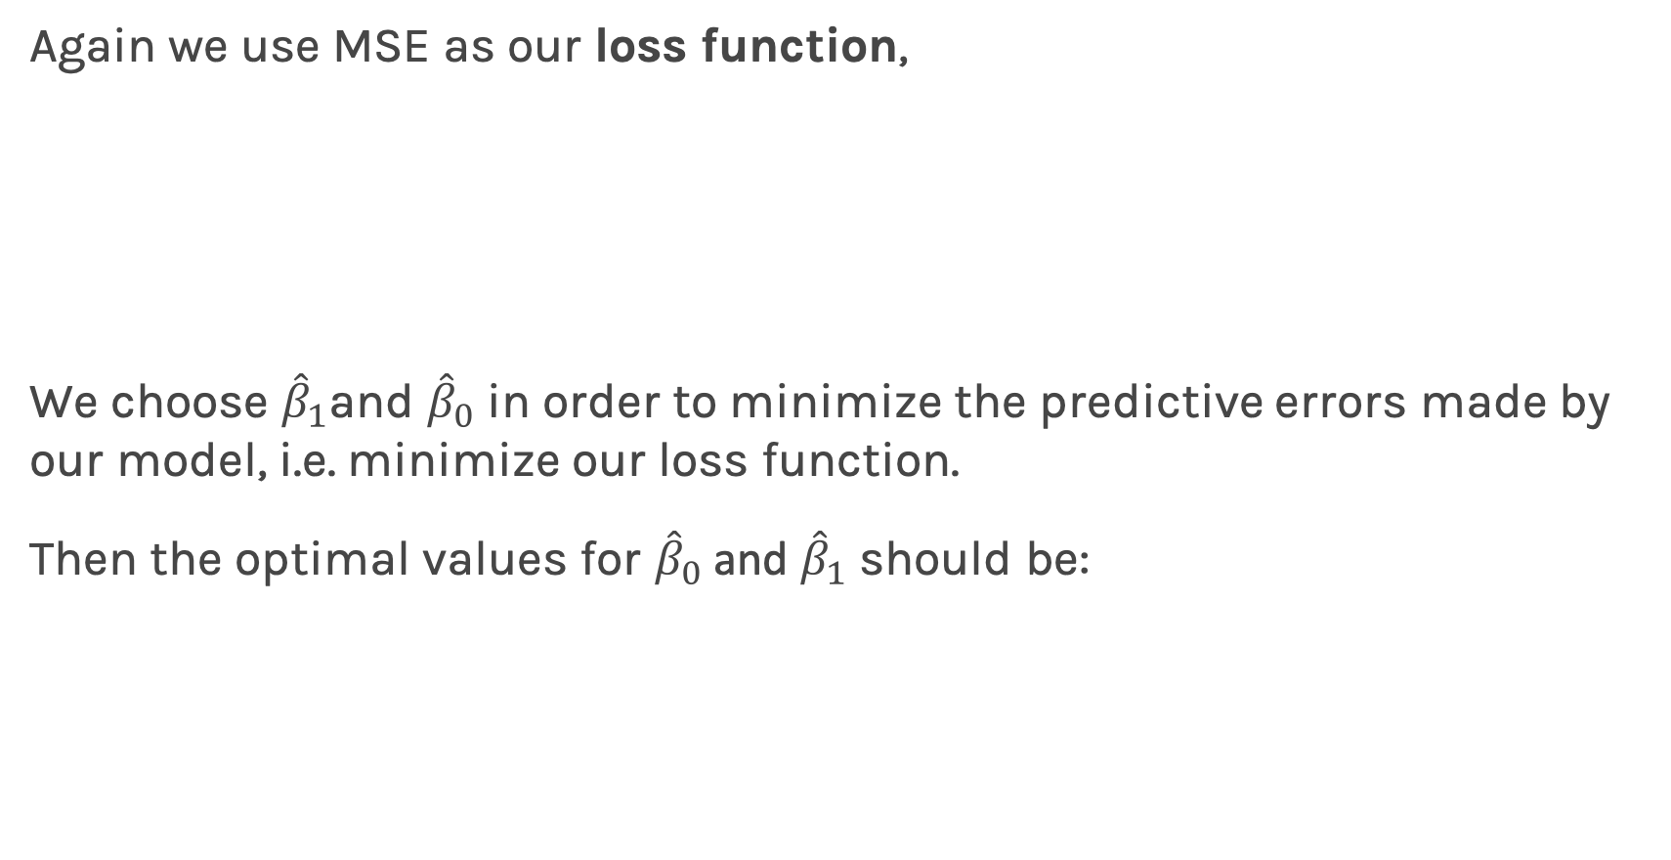
Estimate of the regression coefficients (cont)
Again we use MSE as our loss function,
We choose ${\hat{β}}_{1}$and ${\hat{β}}_{0}$ in order to minimize the predictive errors made by our model, i.e. minimize our loss function.
Then the optimal values for ${\hat{β}}_{0}$ and ${\hat{β}}_{1}$ should be:

Slide 17
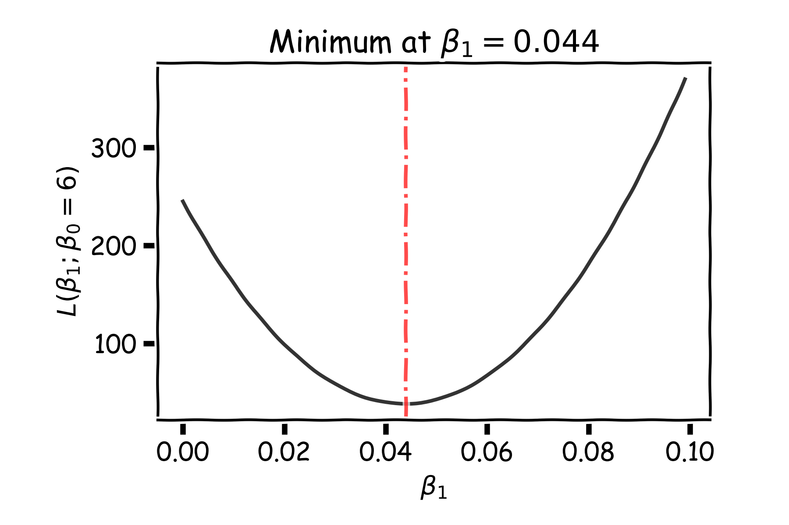
Estimate of the regression coefficients: brute force
A way to estimate ${argmin}_{β_{0},β_{1}}{L}$ is to calculate the loss function for every possible $β_{0}$ and $β_{1}$. Then select the $β_{0}$ and $β_{1}$ where the loss function is minimum.
E.g. the loss function for different $β_{1}$ when $β_{0}$is fixed to be 6:
Notes:
Shall I add a contour plot?

Slide 18
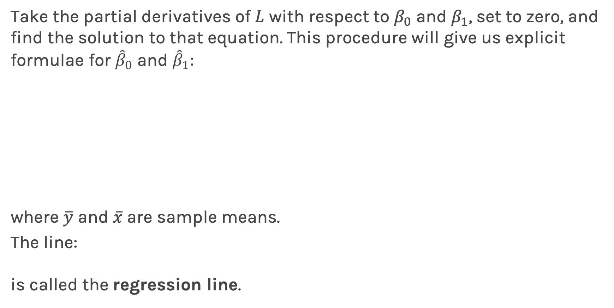
Estimate of the regression coefficients: exact method
Take the partial derivatives of $L$ with respect to $β_{0}$ and $β_{1}$, set to zero, and find the solution to that equation. This procedure will give us explicit formulae for ${\hat{β}}_{0}$ and ${\hat{β}}_{1}:$
where $\overline{y}$ and $\overline{x}$are sample means.
The line:
is called the regression line.

Slide 19
Uncertainty in model and prediction
Cross validation
Overfitting: Variance & Bias
Pandas
NumPy
Scikit-Learn
PCA & dimensionality reduction
Statistical Learning
Computing Tools
Matplotlib
Methods of regularization:
Lasso and Ridge
Regression
Classification
Logistic
Linear
Trees
KNN
Neural Networks
Experimental Design & Causal Inference

Slide 20
Uncertainty in model and prediction
Cross validation
Overfitting: Variance & Bias
Pandas
NumPy
Scikit-Learn
PCA & dimensionality reduction
Statistical Learning
Computing Tools
Matplotlib
Methods of regularization:
Lasso and Ridge
Regression
Classification
Logistic
Linear
Trees
KNN
Neural Networks
Experimental Design & Causal Inference

Slide 21
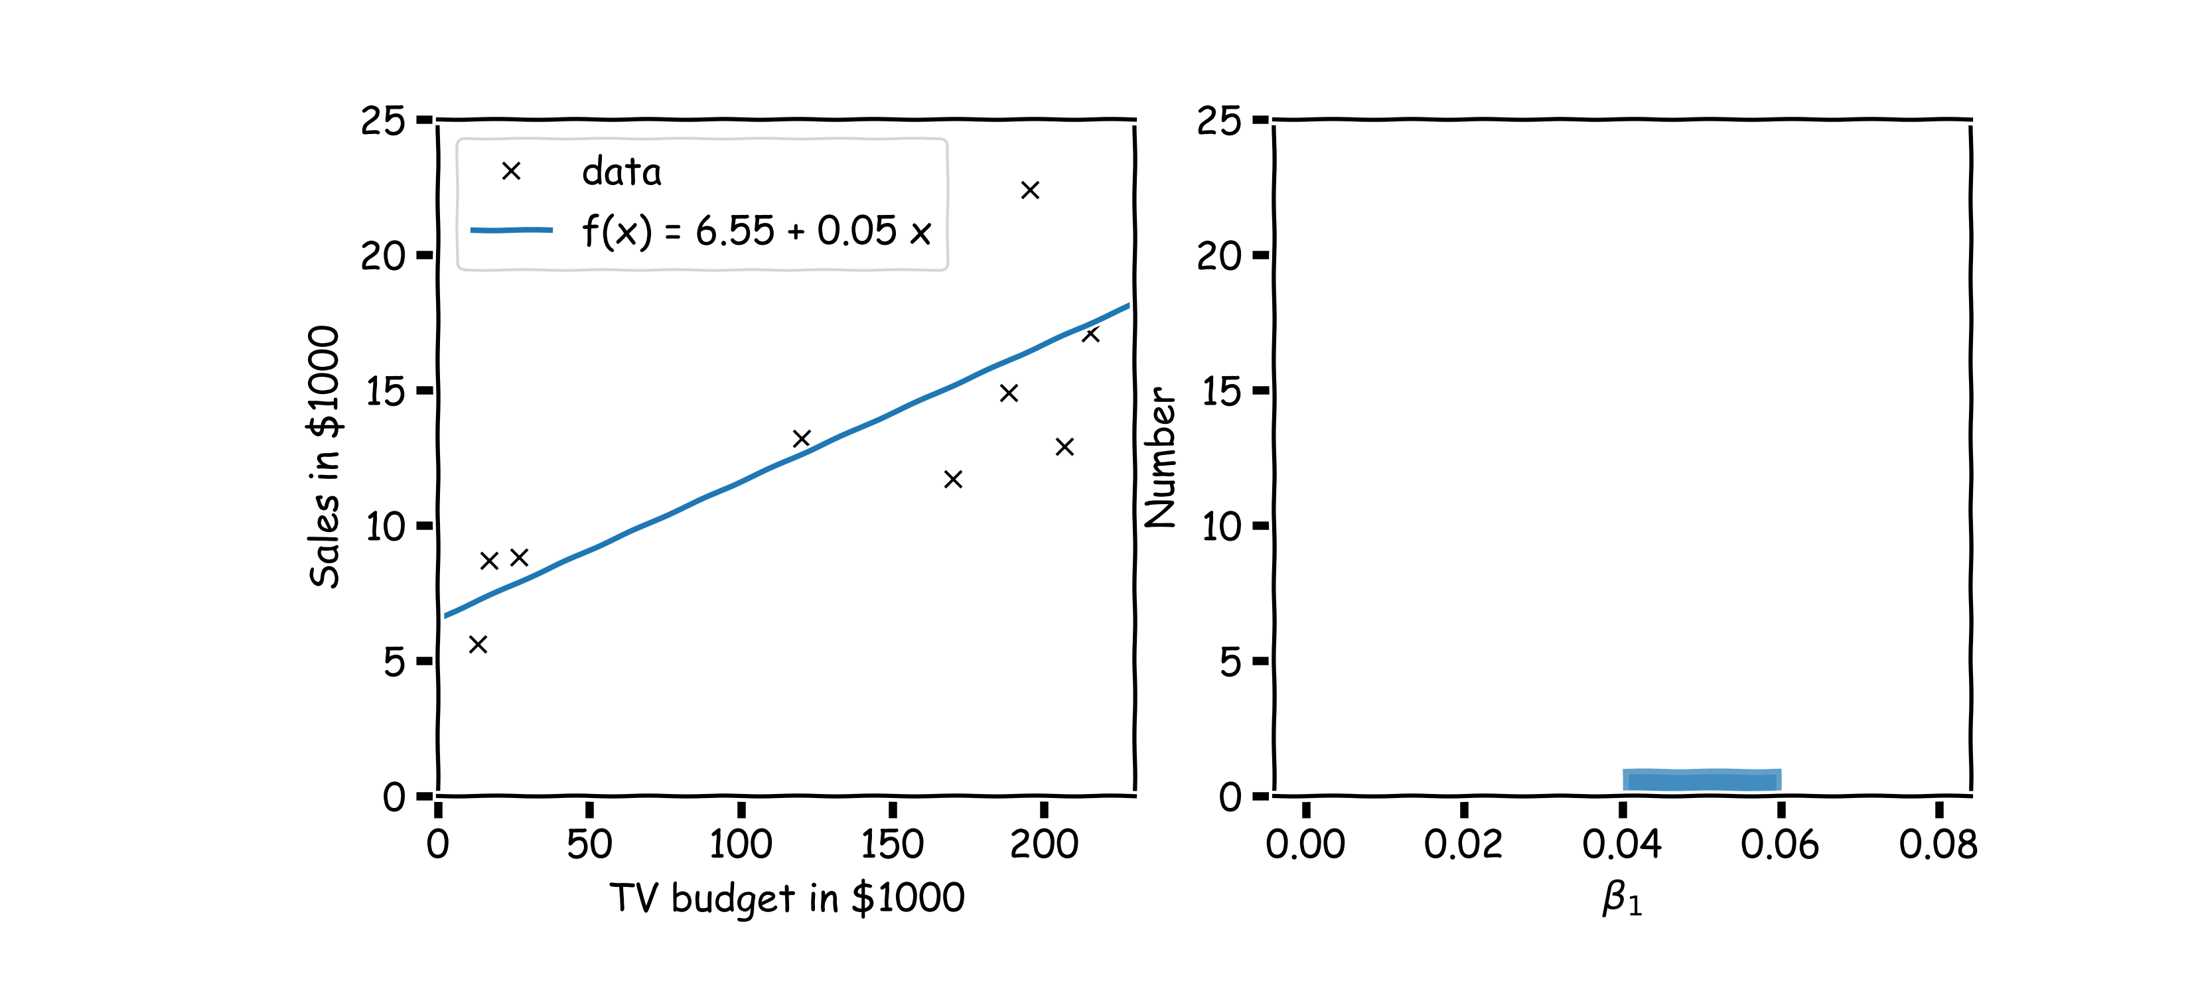
Confidence intervals for the predictors estimates (cont)
$$.$$
In our magical realisms, we can now sample multiple times

Slide 22
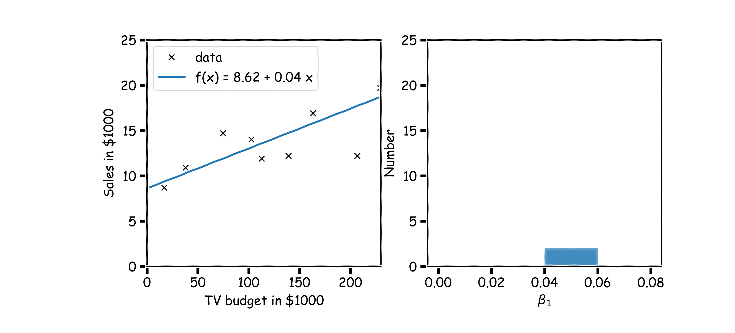
Confidence intervals for the predictors estimates (cont)
Another sample

Slide 23
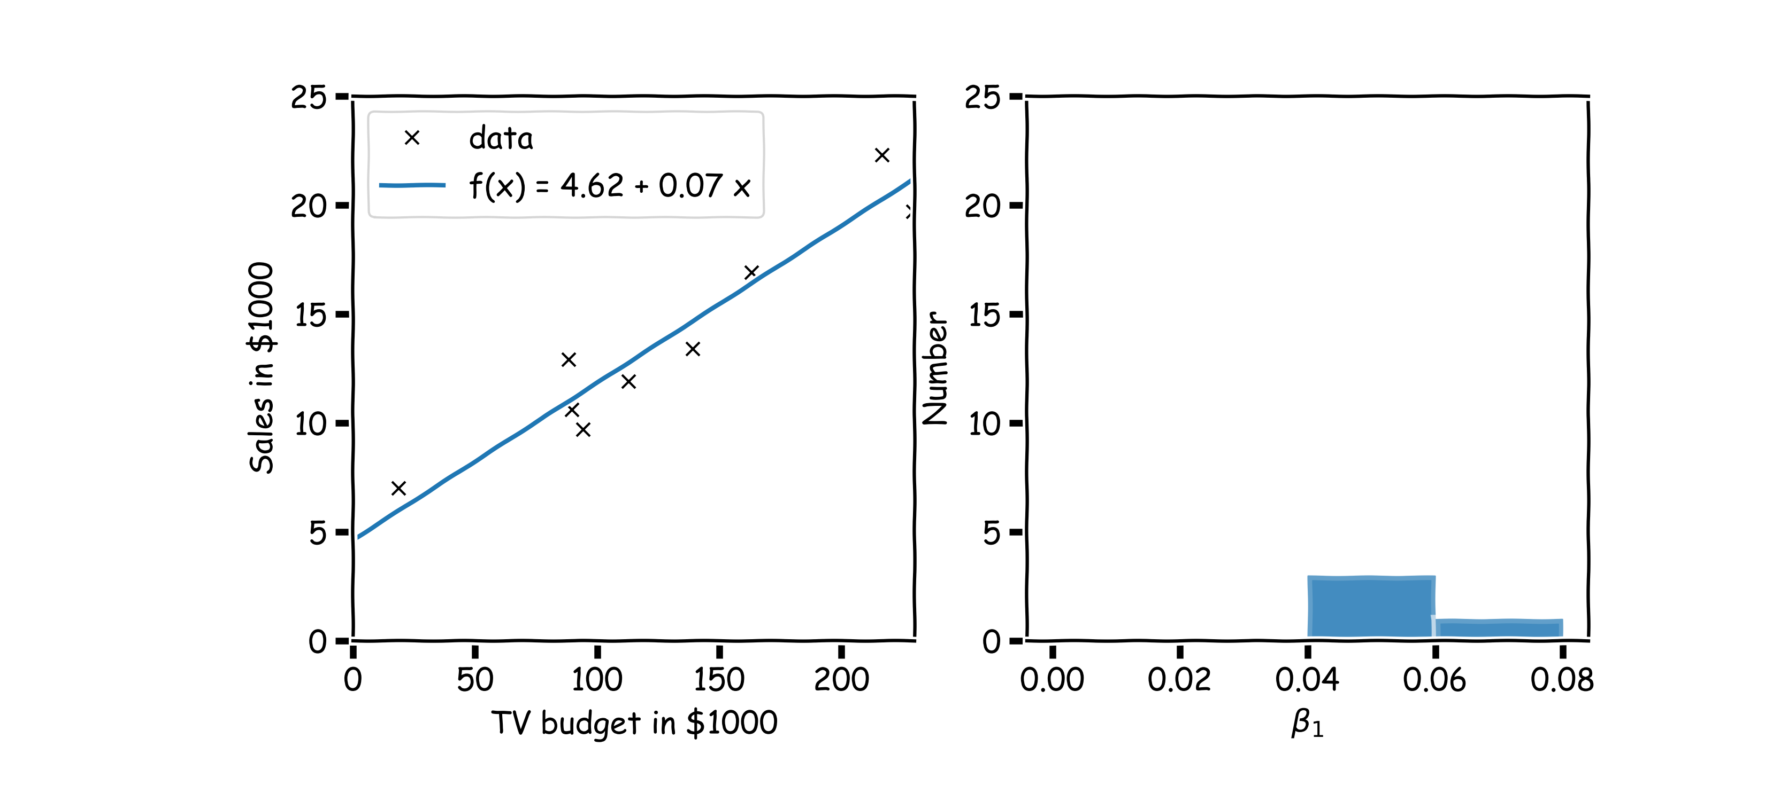
Confidence intervals for the predictors estimates (cont)
Another sample

Slide 24
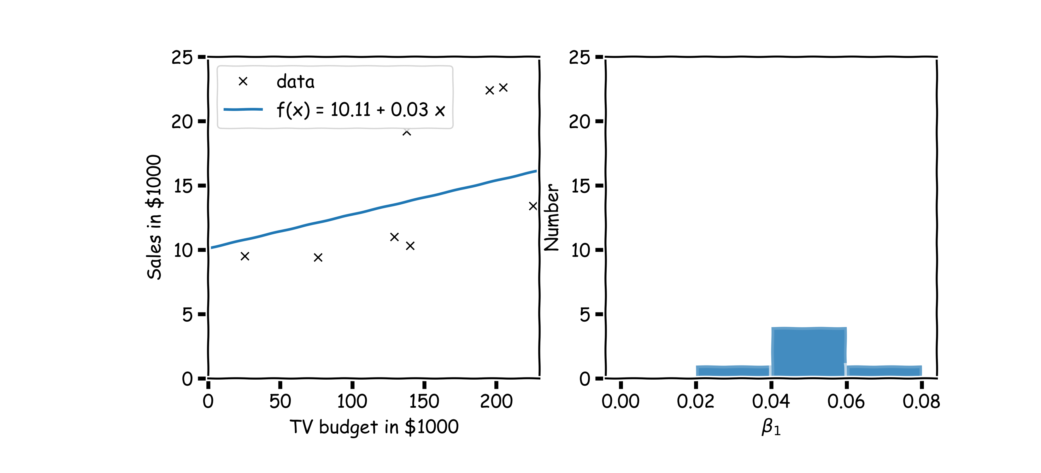
Confidence intervals for the predictors estimates (cont)
And another sample

Slide 25
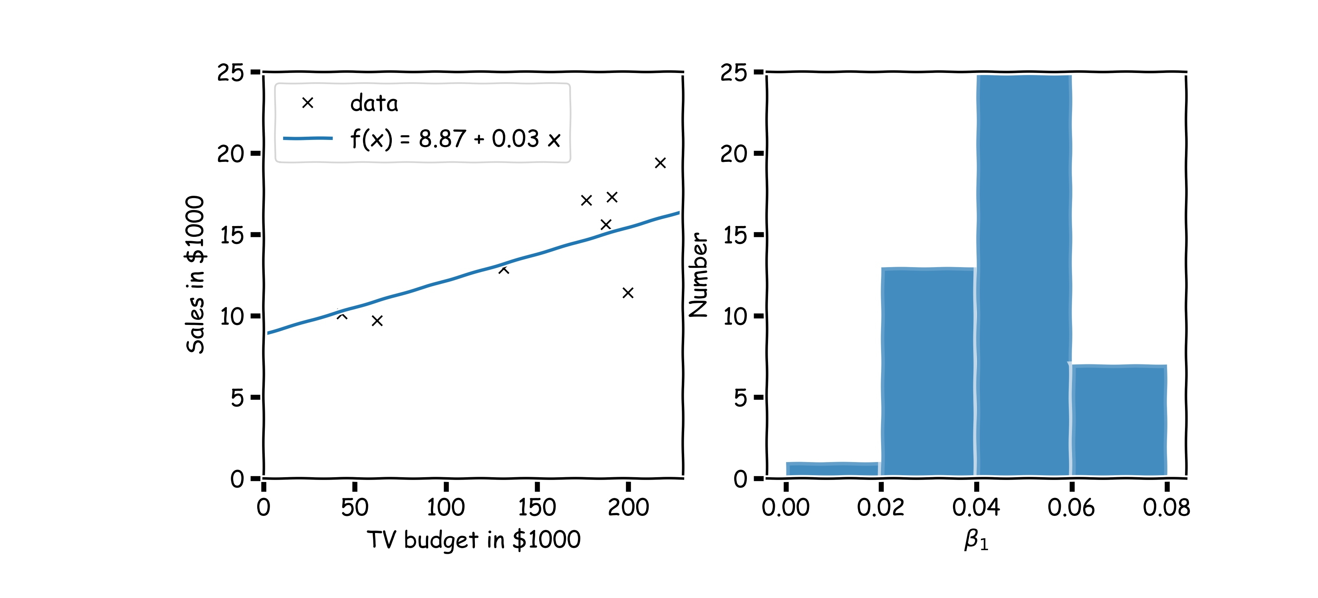
Confidence intervals for the predictors estimates (cont)
Repeat this for 100 times

Slide 26
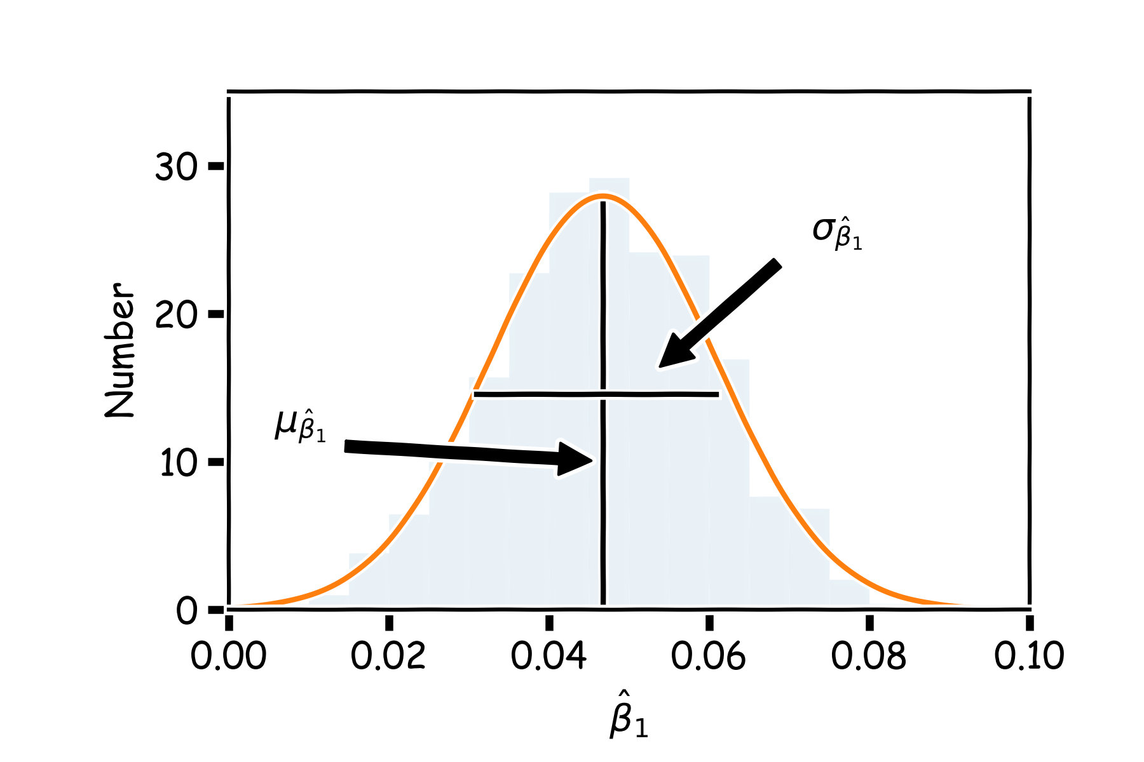
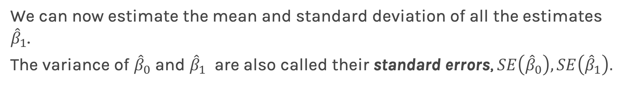
Confidence intervals for the predictors estimates (cont)
We can now estimate the mean and standard deviation of all the estimates ${\hat{β}}_{1}$.
The variance of ${\hat{β}}_{0}$ and ${\hat{β}}_{1}$ are also called their standard errors, $SE\left({\hat{β}}_{0}\right),SE\left({\hat{β}}_{1}\right).$
2

Slide 27
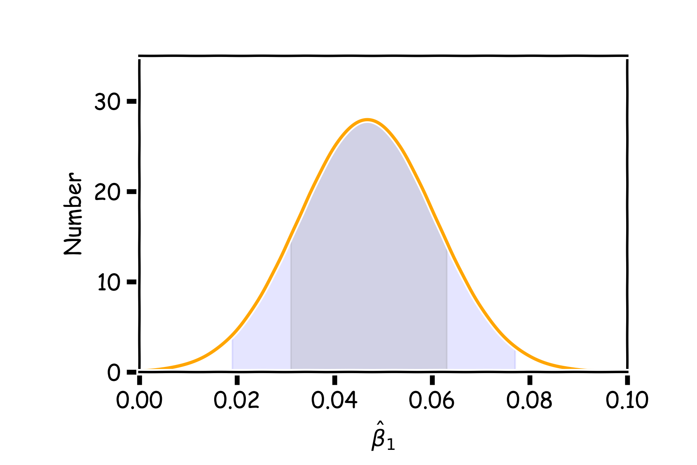
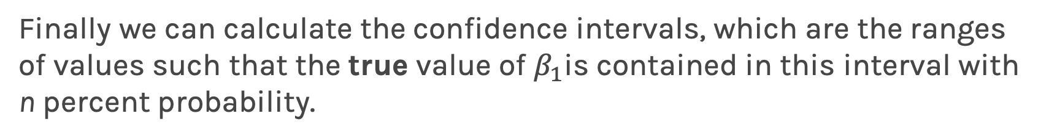
Confidence intervals for the predictors estimates (cont)
Finally we can calculate the confidence intervals, which are the ranges of values such that the true value of $β_{1}$is contained in this interval with n percent probability.
95%
68%

Slide 28
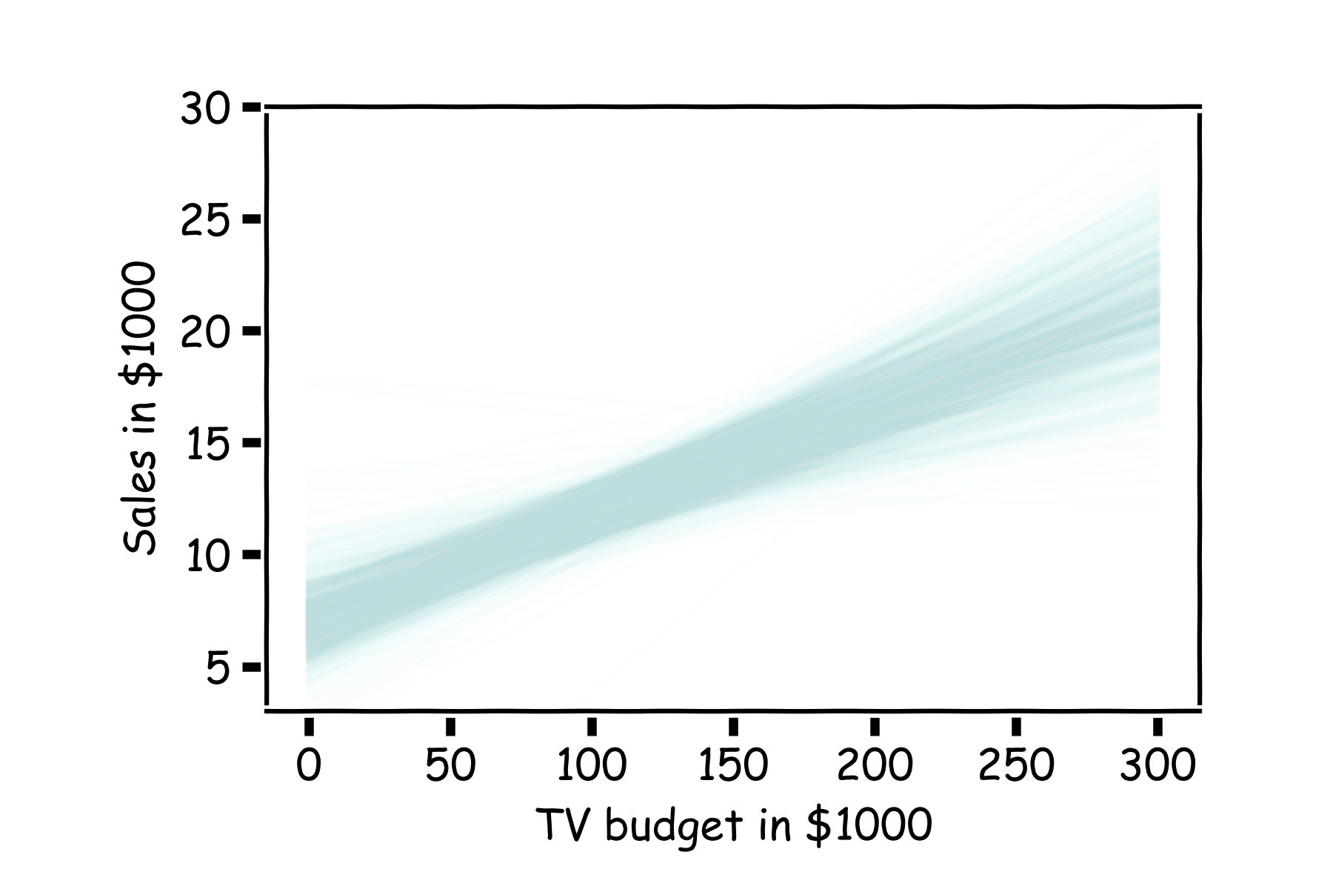
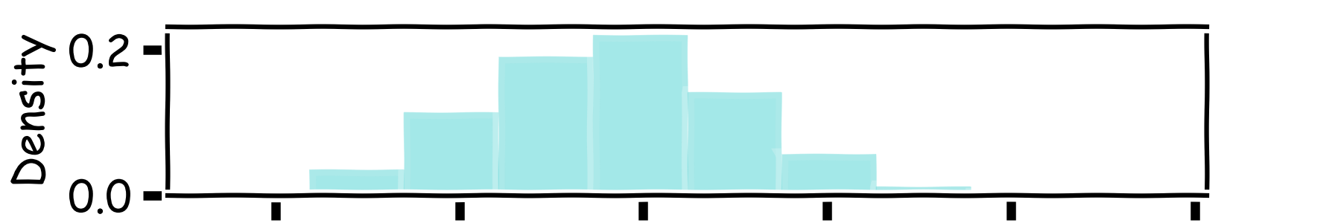
How well do we know $\hat{f}$?
Below we show all regression lines for a thousand of such bootstrapped samples.
For a given $x$, we examine the distribution of $\hat{f}$, and determine the mean and standard deviation.

Slide 29
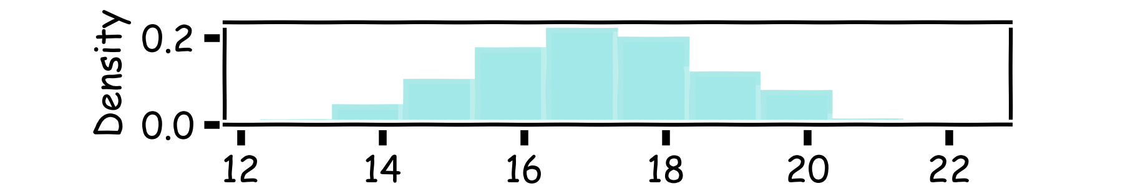
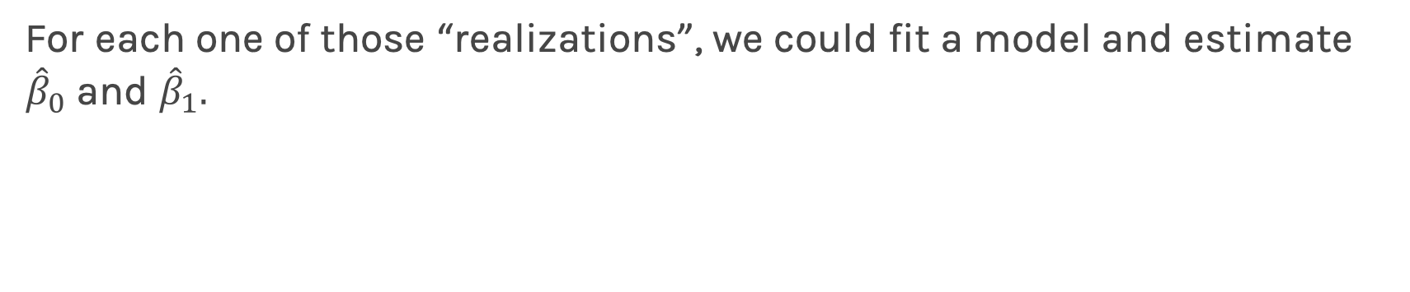
How well do we know $\hat{f}$?
Below we show all regression lines for a thousand of such sub-samples.
For a given $x$, we examine the distribution of $\hat{f}$, and determine the mean and standard deviation.

Slide 30
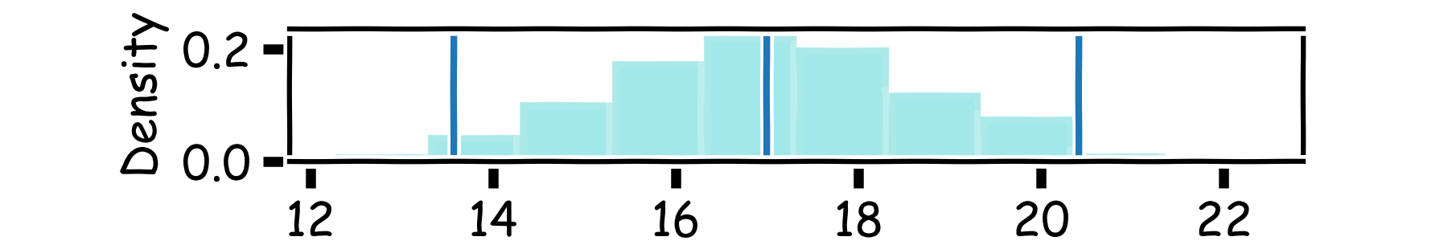
How well do we know $\hat{f}$?
Below we show all regression lines for a thousand of such sub-samples.
For a given $x$, we examine the distribution of $\hat{f}$, and determine the mean and standard deviation.

Slide 31
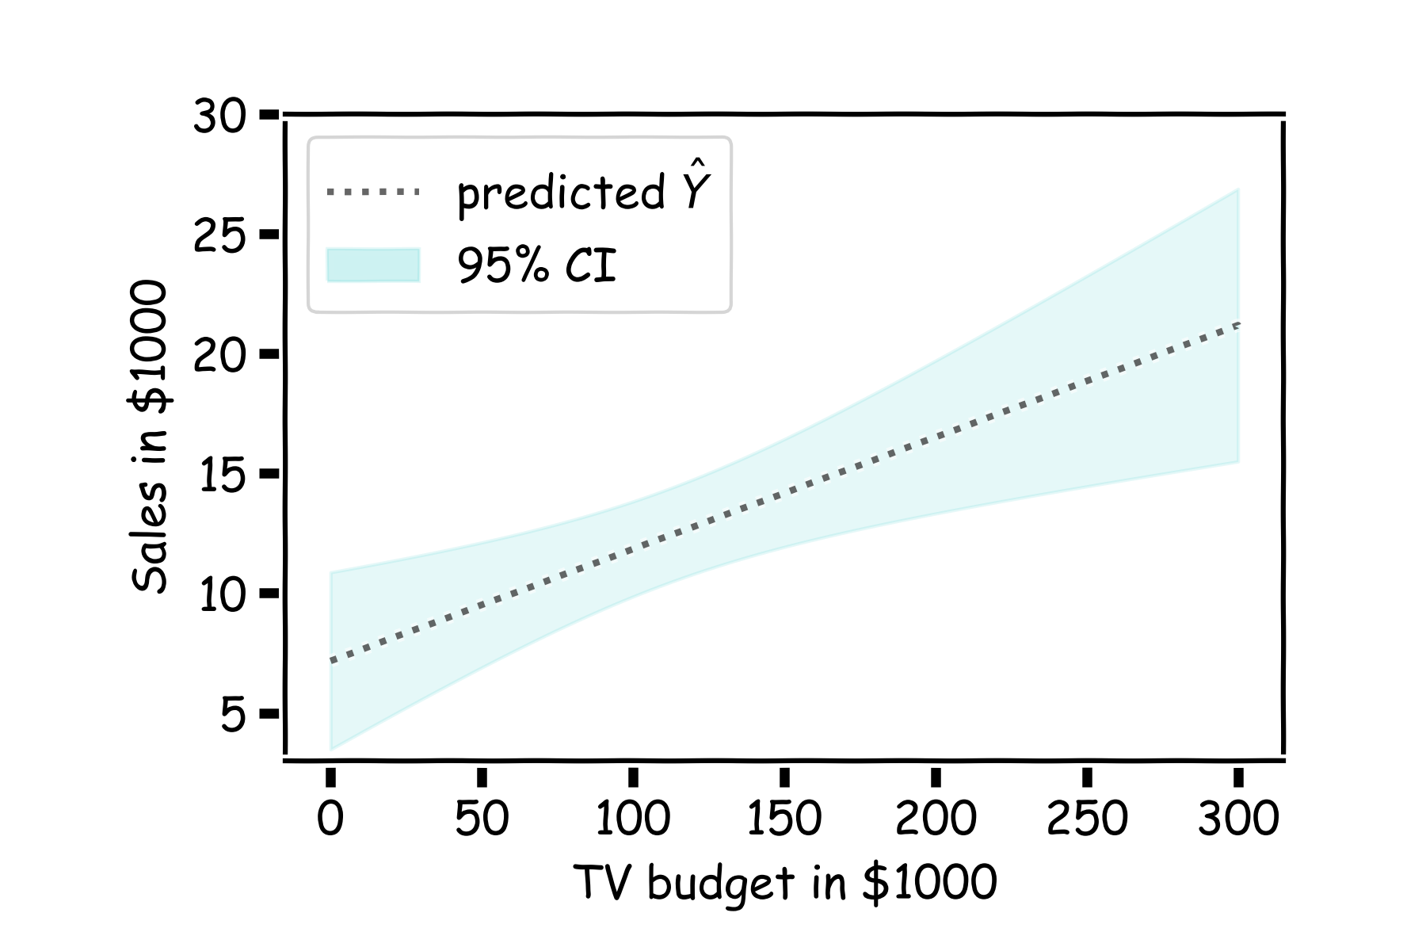
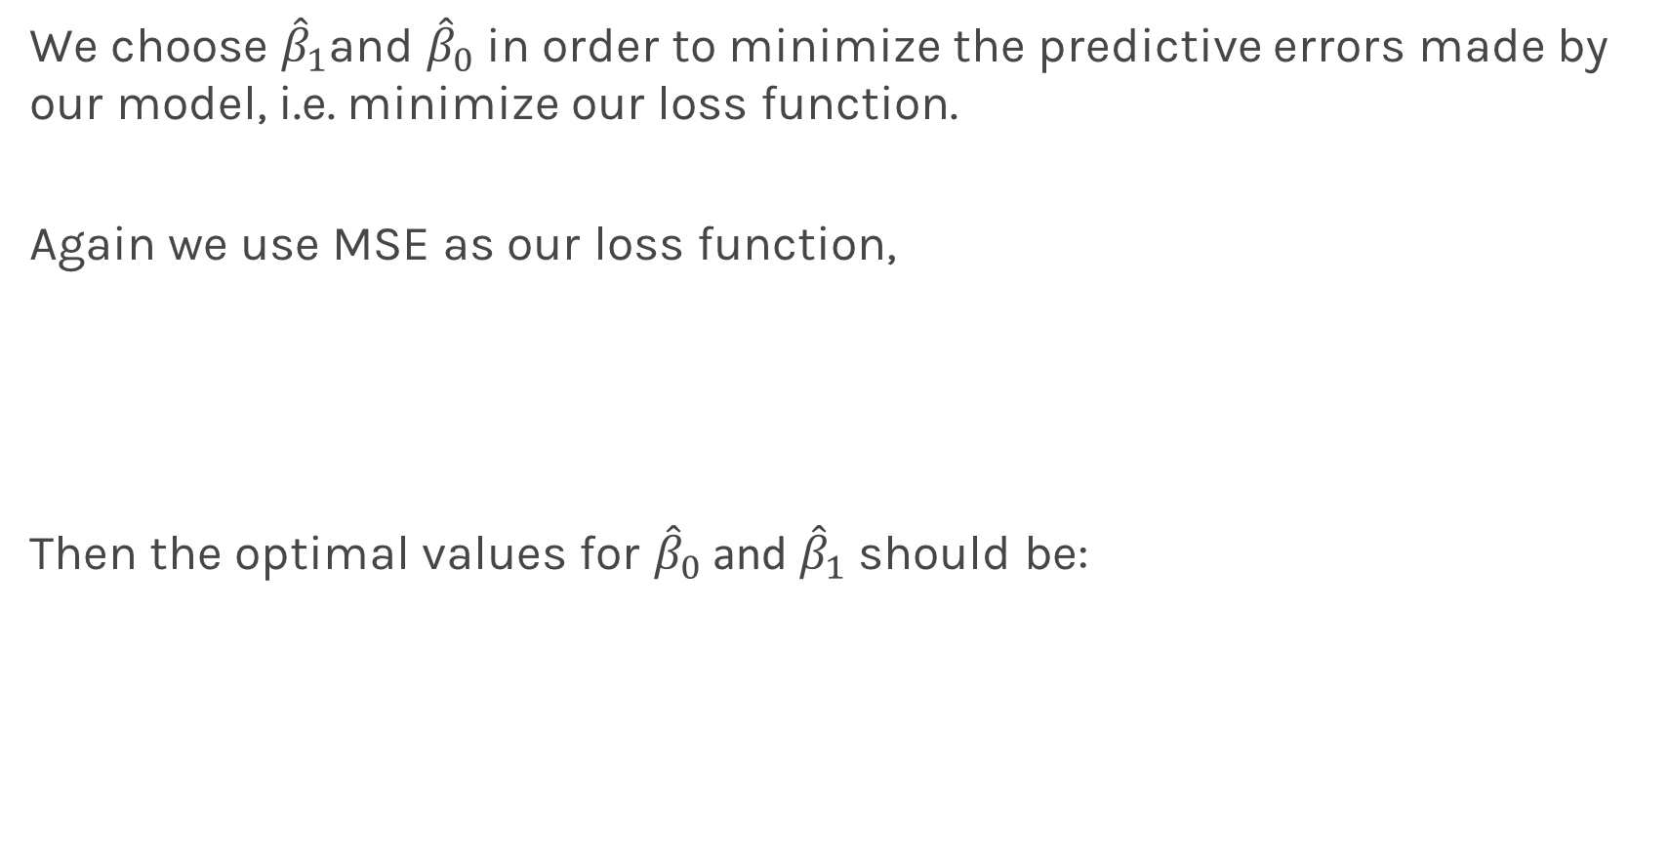
How well do we know $\hat{f}$?
For every $x$, we calculate the mean of the models, $\hat{f}$ (shown with dotted line) and the 95% CI of those models (shaded area).
Estimated $\hat{f}$

Slide 32
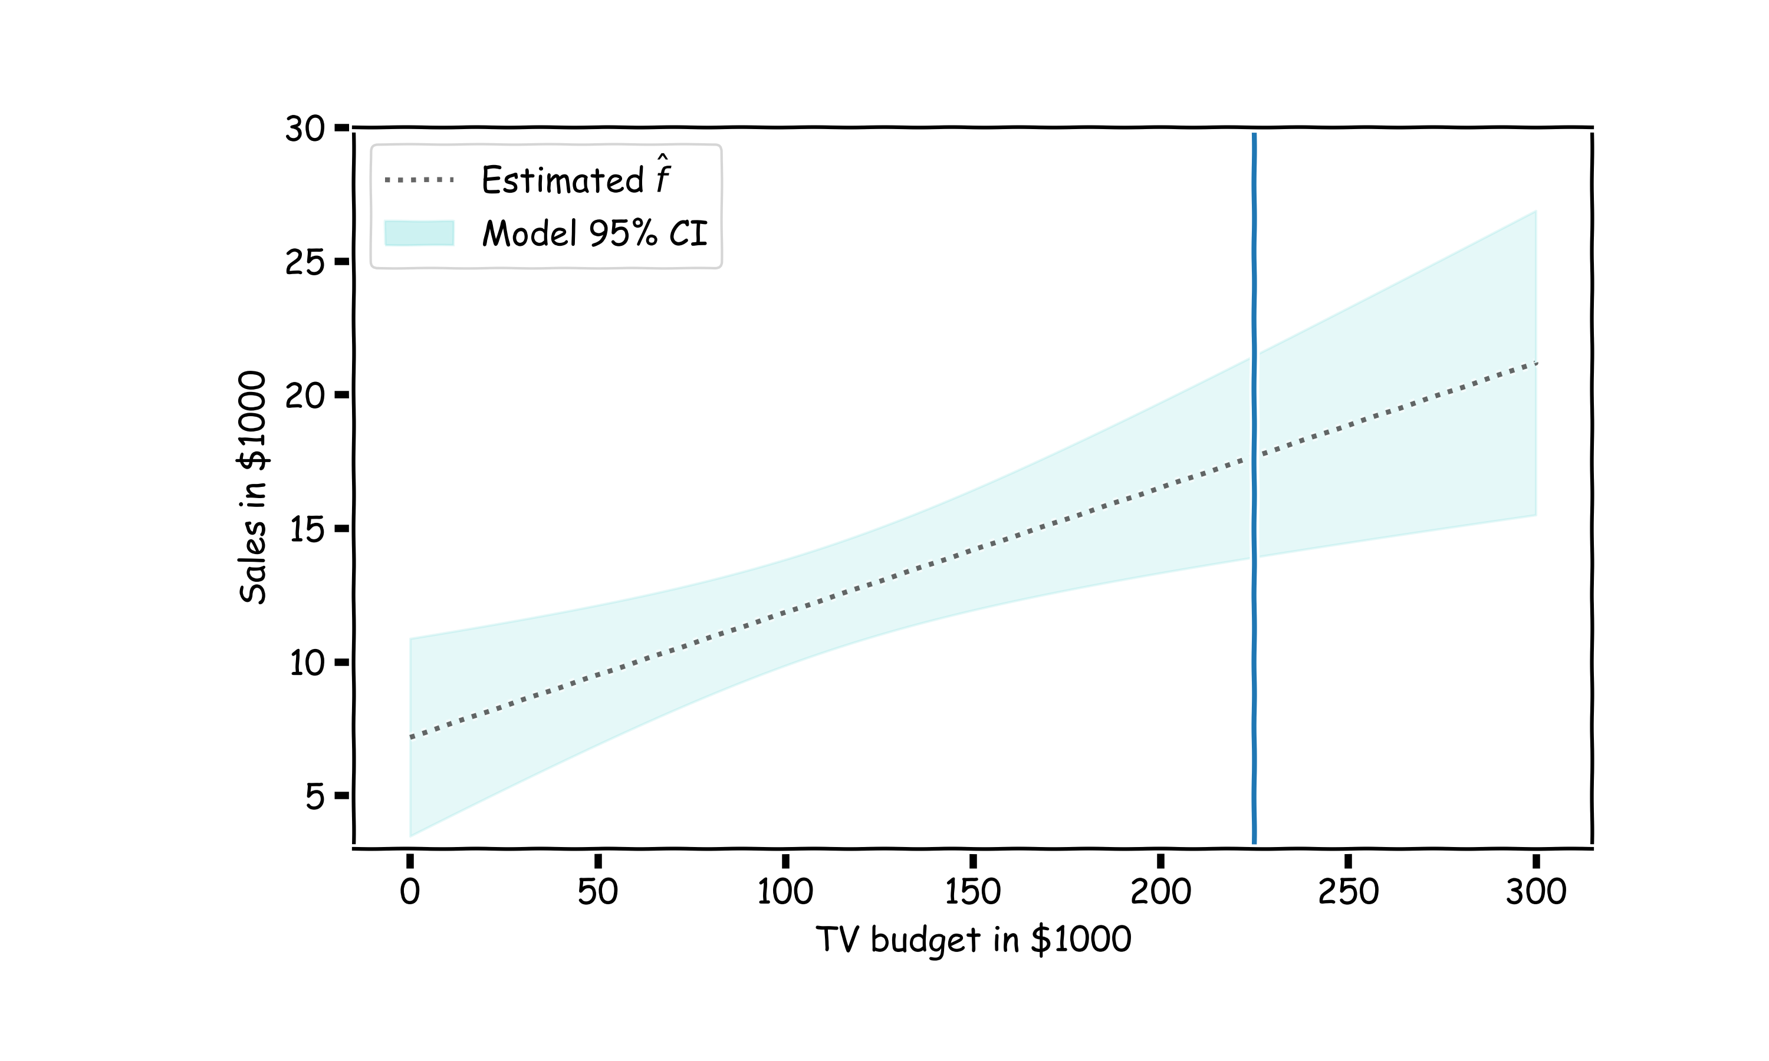
Confidence in predicting $\hat{y}$

Slide 33

Confidence in predicting $\hat{y}$
for a given x, we have a distribution of models $f\left(x\right)$
for each of these $f\left(x\right),$the prediction for $y\sim N(f, σ_{ε})$

Slide 34
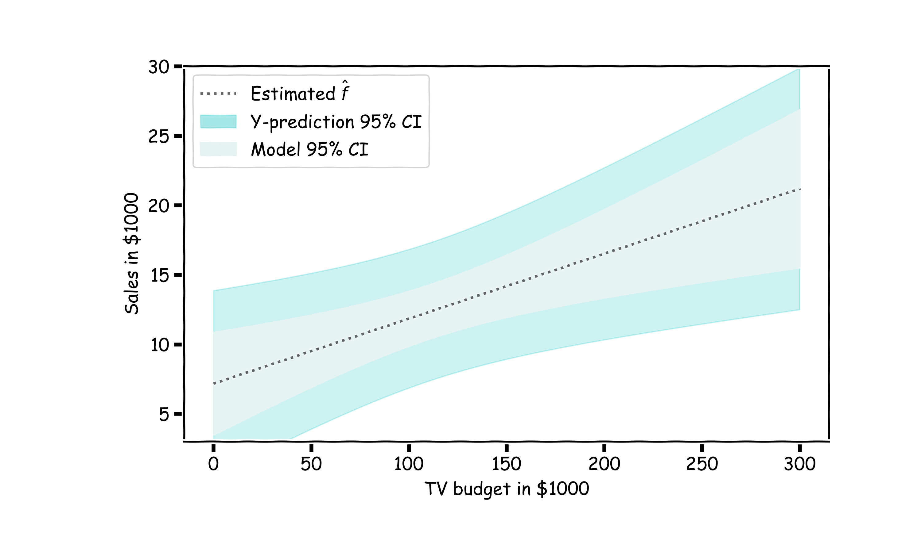
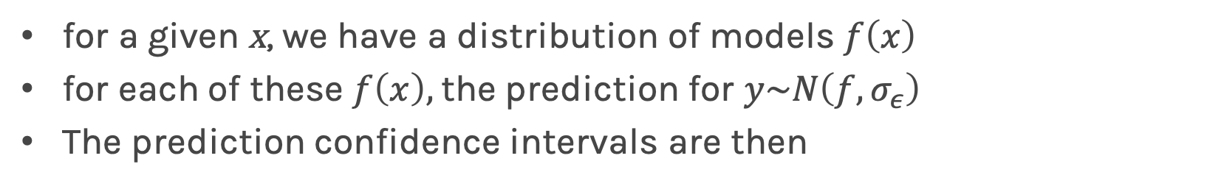
Confidence in predicting $\hat{y}$
for a given x, we have a distribution of models $f\left(x\right)$
for each of these $f\left(x\right),$the prediction for $y\sim N\left(f, σ_{ε}\right)$
The prediction confidence intervals are then

Slide 35
Uncertainty in model and prediction
Cross validation
Overfitting: Variance & Bias
Pandas
NumPy
Scikit-Learn
PCA & dimensionality reduction
Statistical Learning
Computing Tools
Matplotlib
Methods of regularization:
Lasso and Ridge
Regression
Classification
Logistic
Linear
Trees
KNN
Neural Networks
Experimental Design & Causal Inference

Slide 36
Uncertainty in model and prediction
Cross validation
Overfitting: Variance & Bias
Pandas
NumPy
Scikit-Learn
PCA & dimensionality reduction
Statistical Learning
Computing Tools
Matplotlib
Methods of regularization:
Lasso and Ridge
Regression
Classification
Logistic
Linear
Trees
KNN
Neural Networks
Experimental Design & Causal Inference

Slide 37
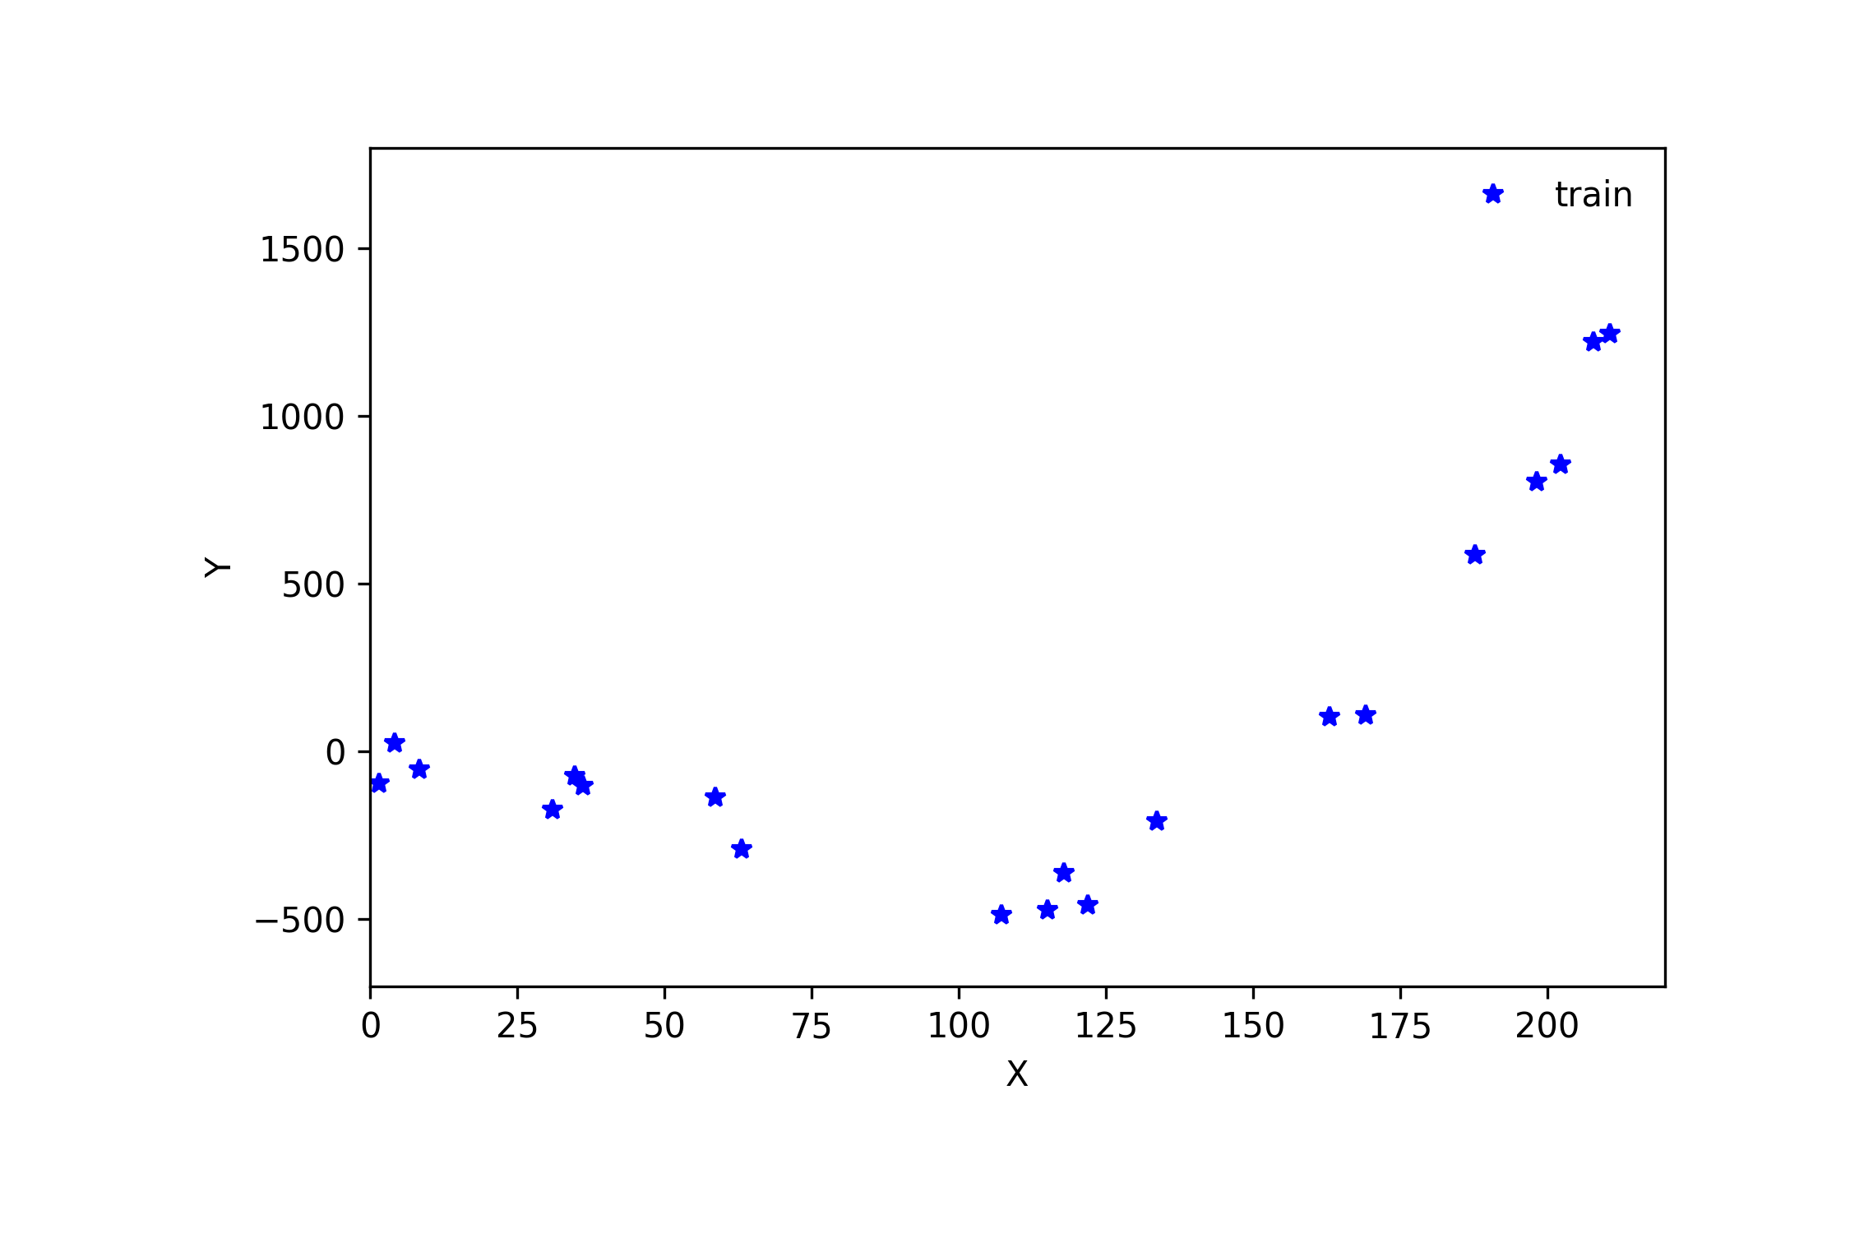
Cross Validation

Slide 38
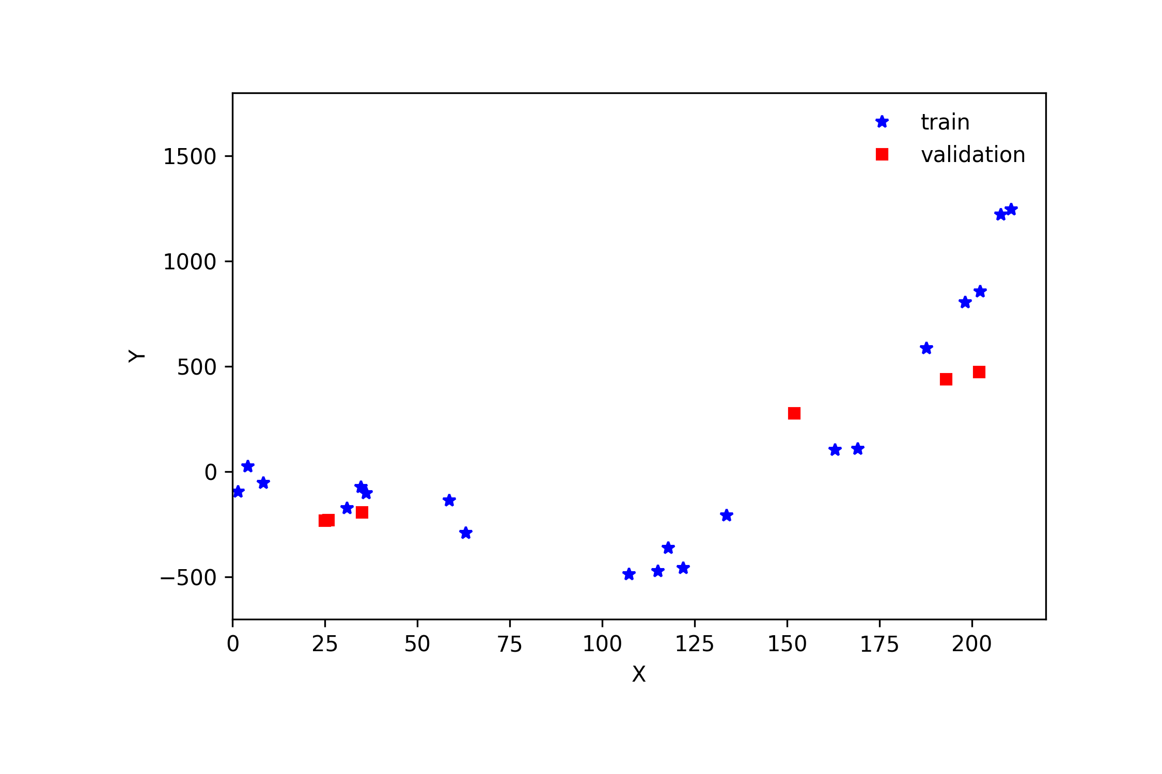
Cross Validation

Slide 39
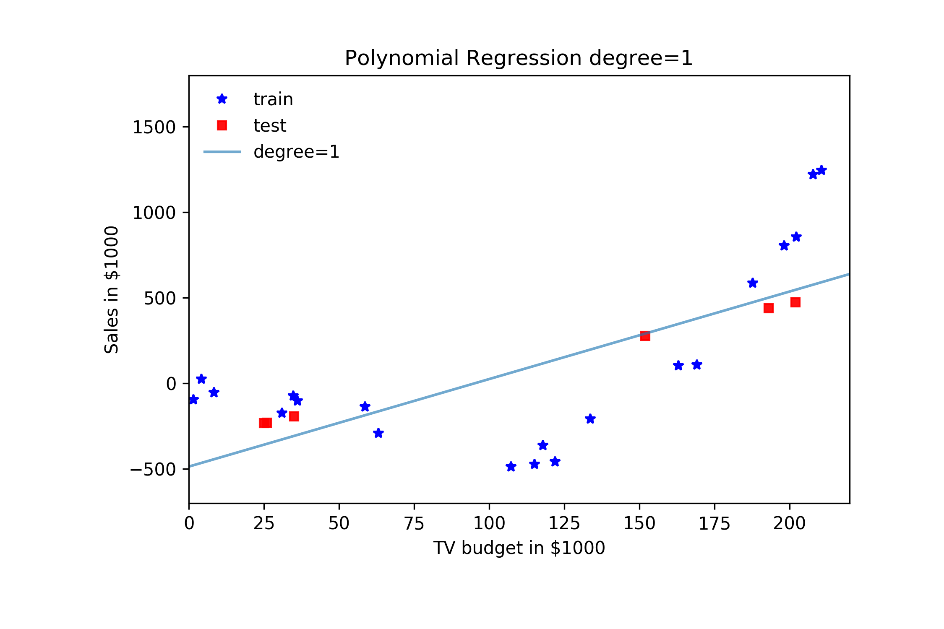
Cross Validation

Slide 40
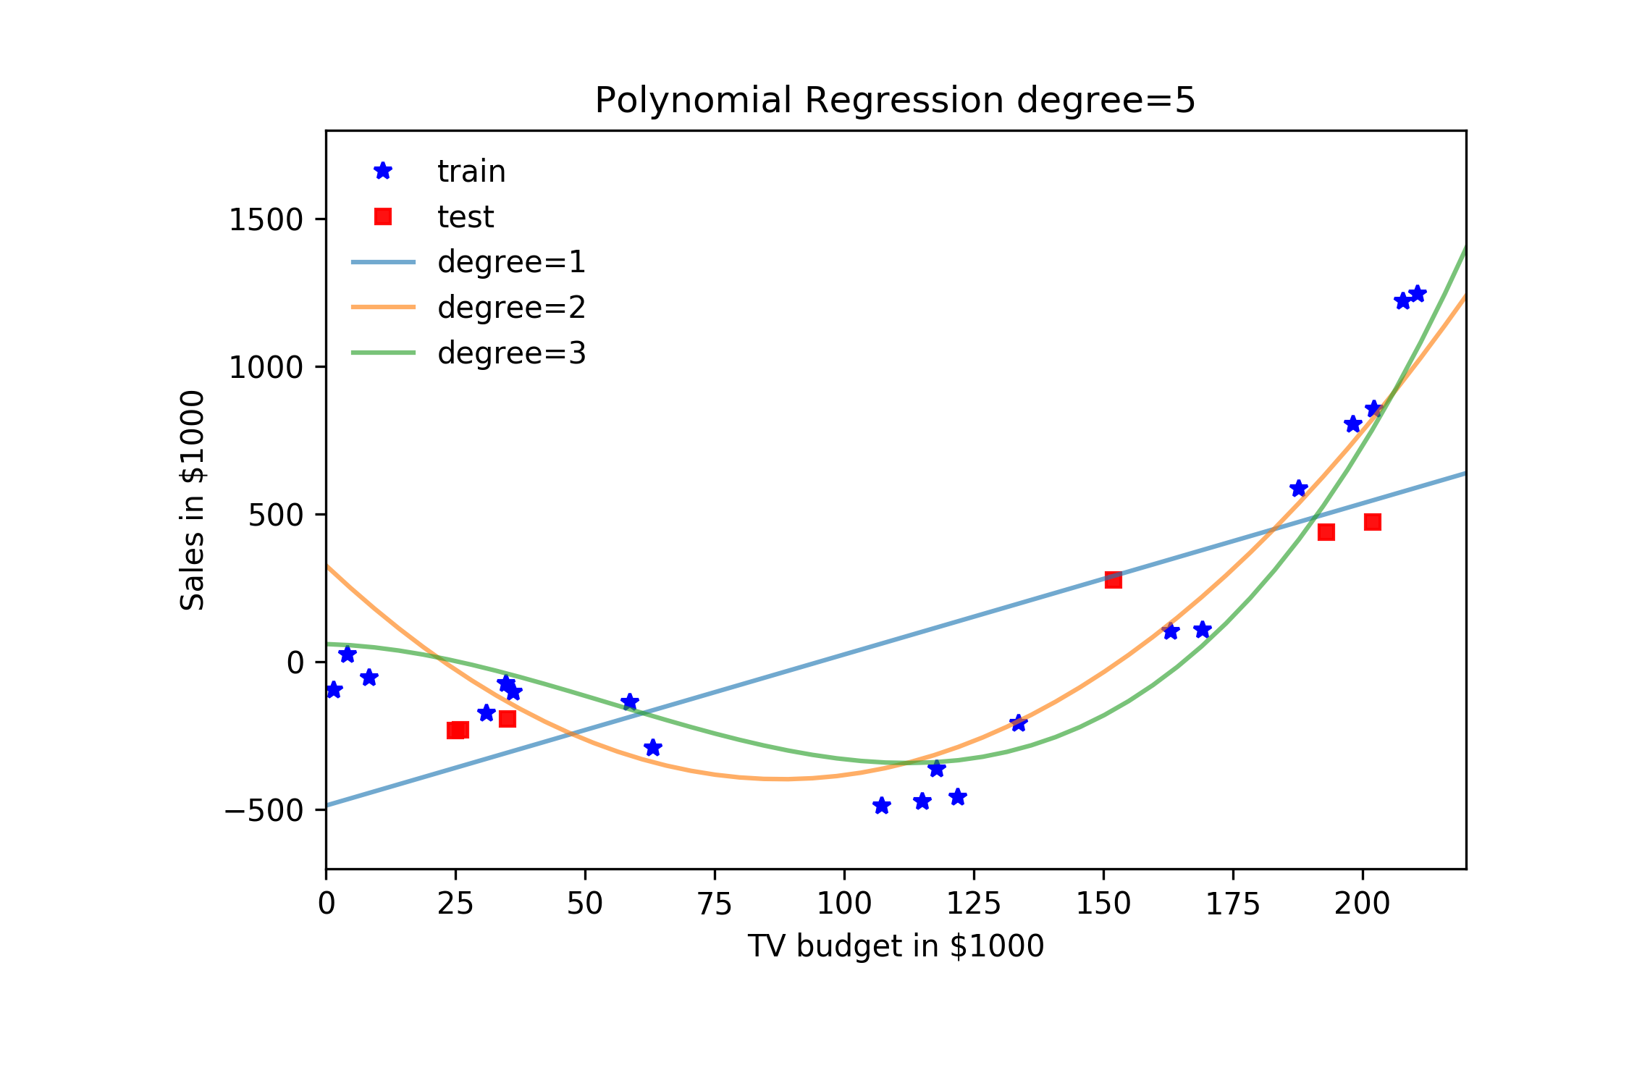
Cross Validation

Slide 41
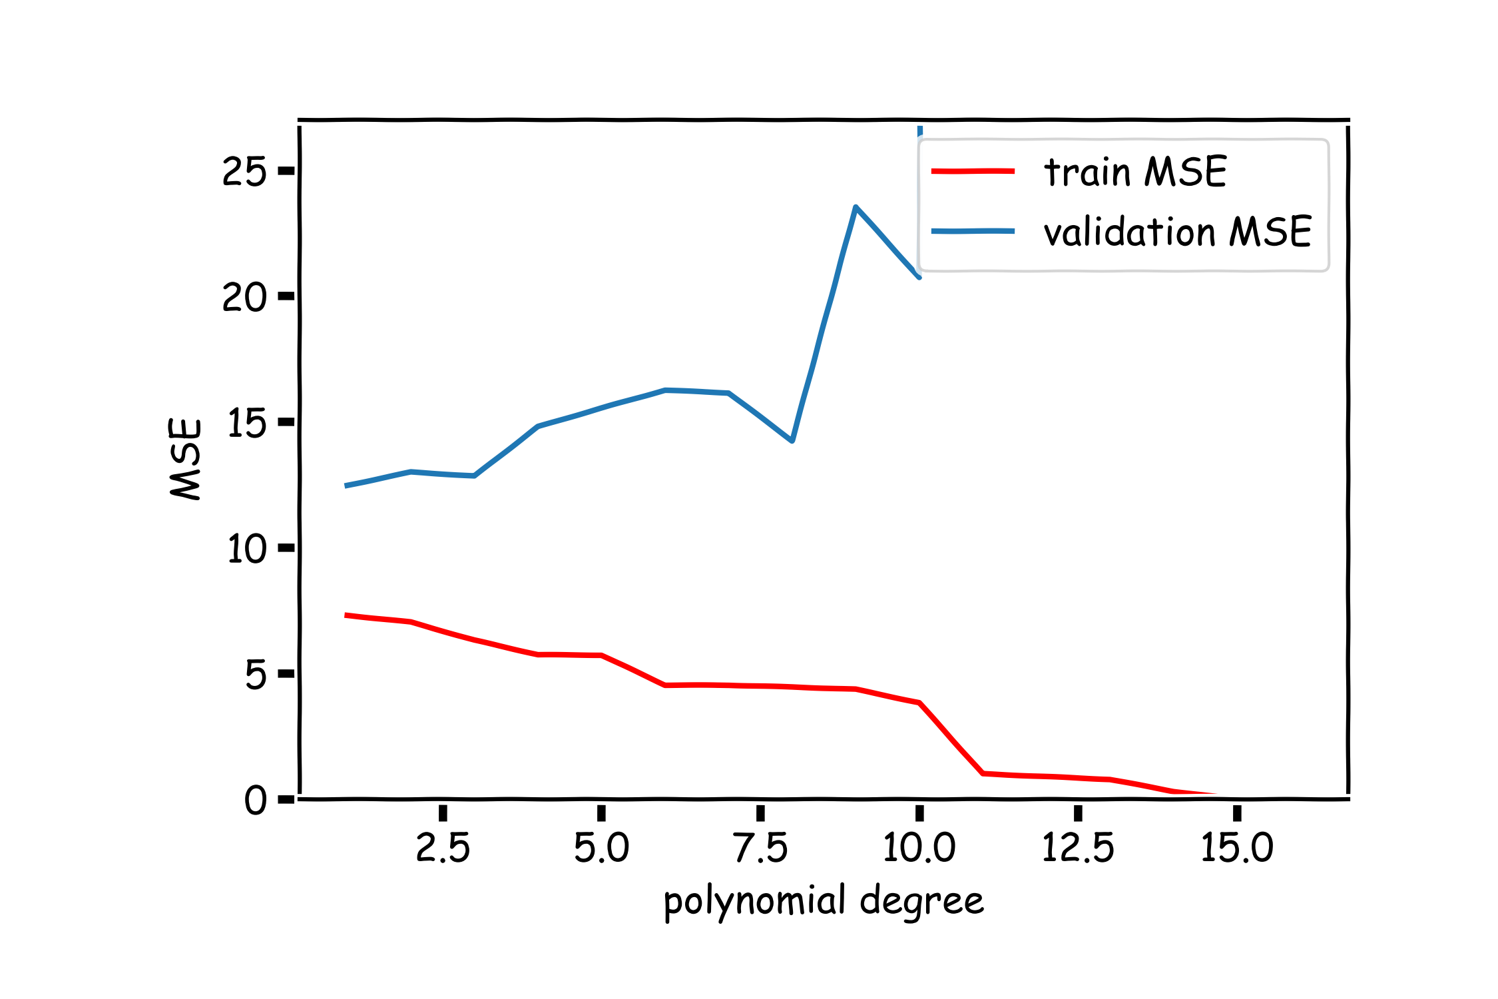
Validation

Slide 42
Cross Validation

Slide 43
Uncertainty in model and prediction
Cross validation
Overfitting: Variance & Bias
Pandas
NumPy
Scikit-Learn
PCA & dimensionality reduction
Statistical Learning
Computing Tools
Matplotlib
Methods of regularization:
Lasso and Ridge
Regression
Classification
Logistic
Linear
Trees
KNN
Neural Networks
Experimental Design & Causal Inference

Slide 44
Uncertainty in model and prediction
Cross validation
Overfitting: Variance & Bias
Pandas
NumPy
Scikit-Learn
PCA & dimensionality reduction
Statistical Learning
Computing Tools
Matplotlib
Methods of regularization:
Lasso and Ridge
Regression
Classification
Logistic
Linear
Trees
KNN
Neural Networks
Experimental Design & Causal Inference

Slide 47
Uncertainty in model and prediction
Cross validation
Overfitting: Variance & Bias
Pandas
NumPy
Scikit-Learn
PCA & dimensionality reduction
Statistical Learning
Computing Tools
Matplotlib
Methods of regularization:
Lasso and Ridge
Regression
Classification
Logistic
Linear
Trees
KNN
Neural Networks
Experimental Design & Causal Inference

Slide 48
Uncertainty in model and prediction
Cross validation
Overfitting: Variance & Bias
Pandas
NumPy
Scikit-Learn
PCA & dimensionality reduction
Statistical Learning
Computing Tools
Matplotlib
Methods of regularization:
Lasso and Ridge
Regression
Classification
Logistic
Linear
Trees
KNN
Neural Networks
Experimental Design & Causal Inference

Slide 49
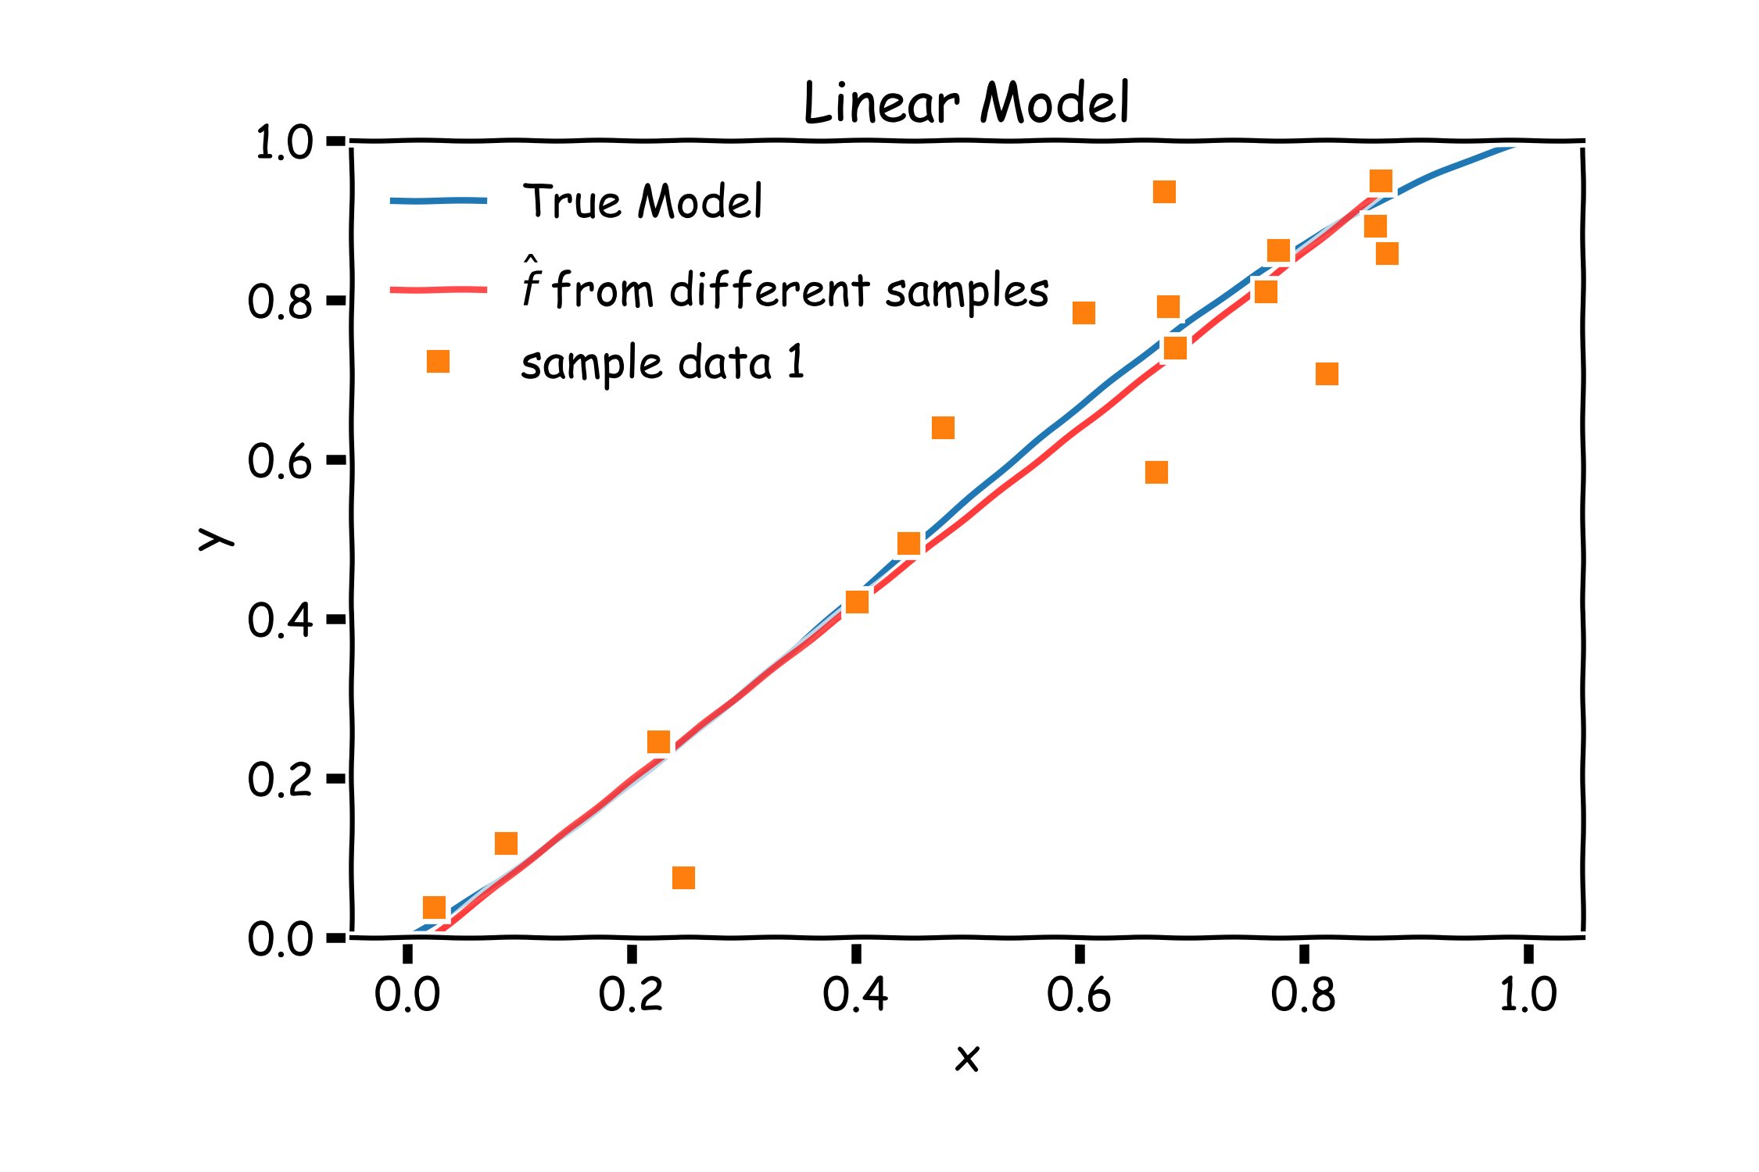
Bias vs Variance

Slide 50
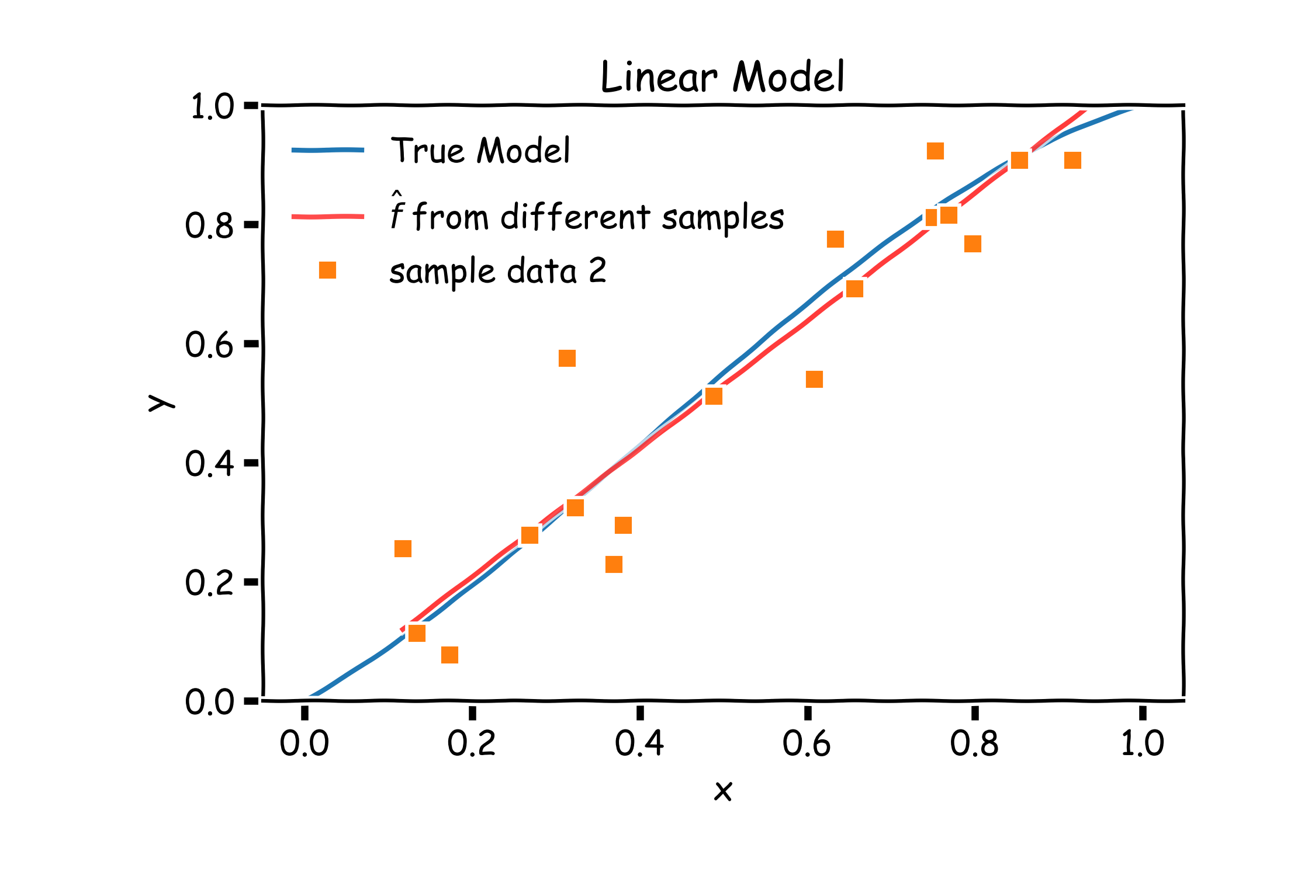
Bias vs Variance

Slide 51
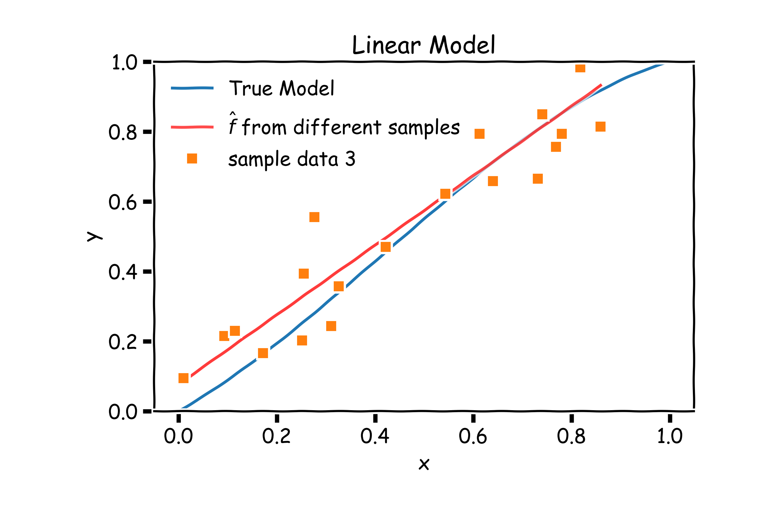
Bias vs Variance

Slide 52
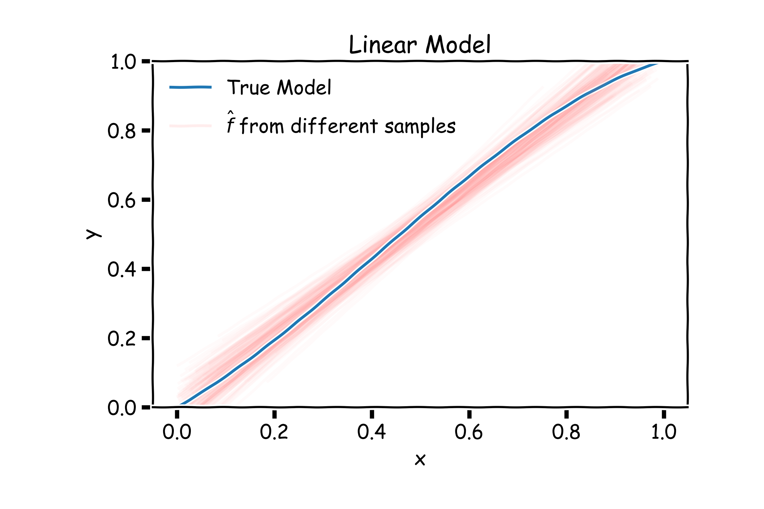
Linear models: 20 data points per line 2000 simulations

Slide 53
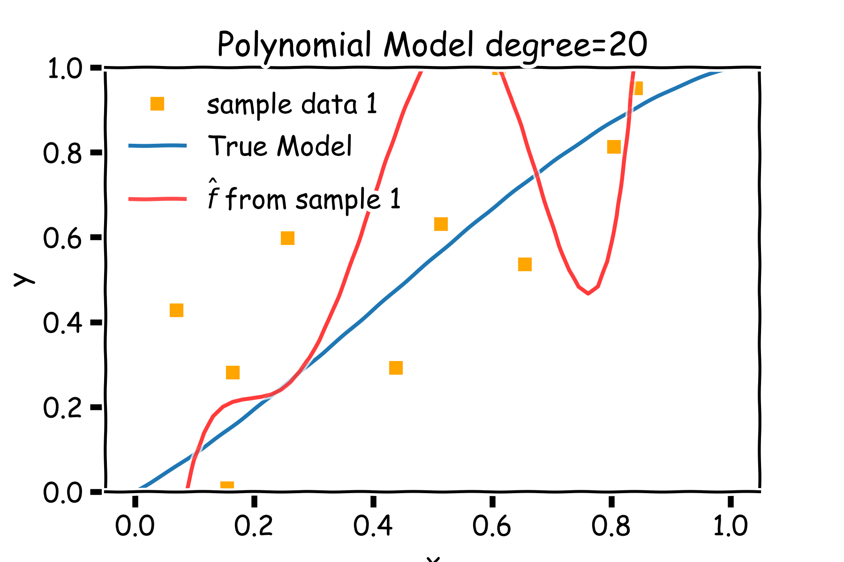
Bias vs Variance

Slide 54
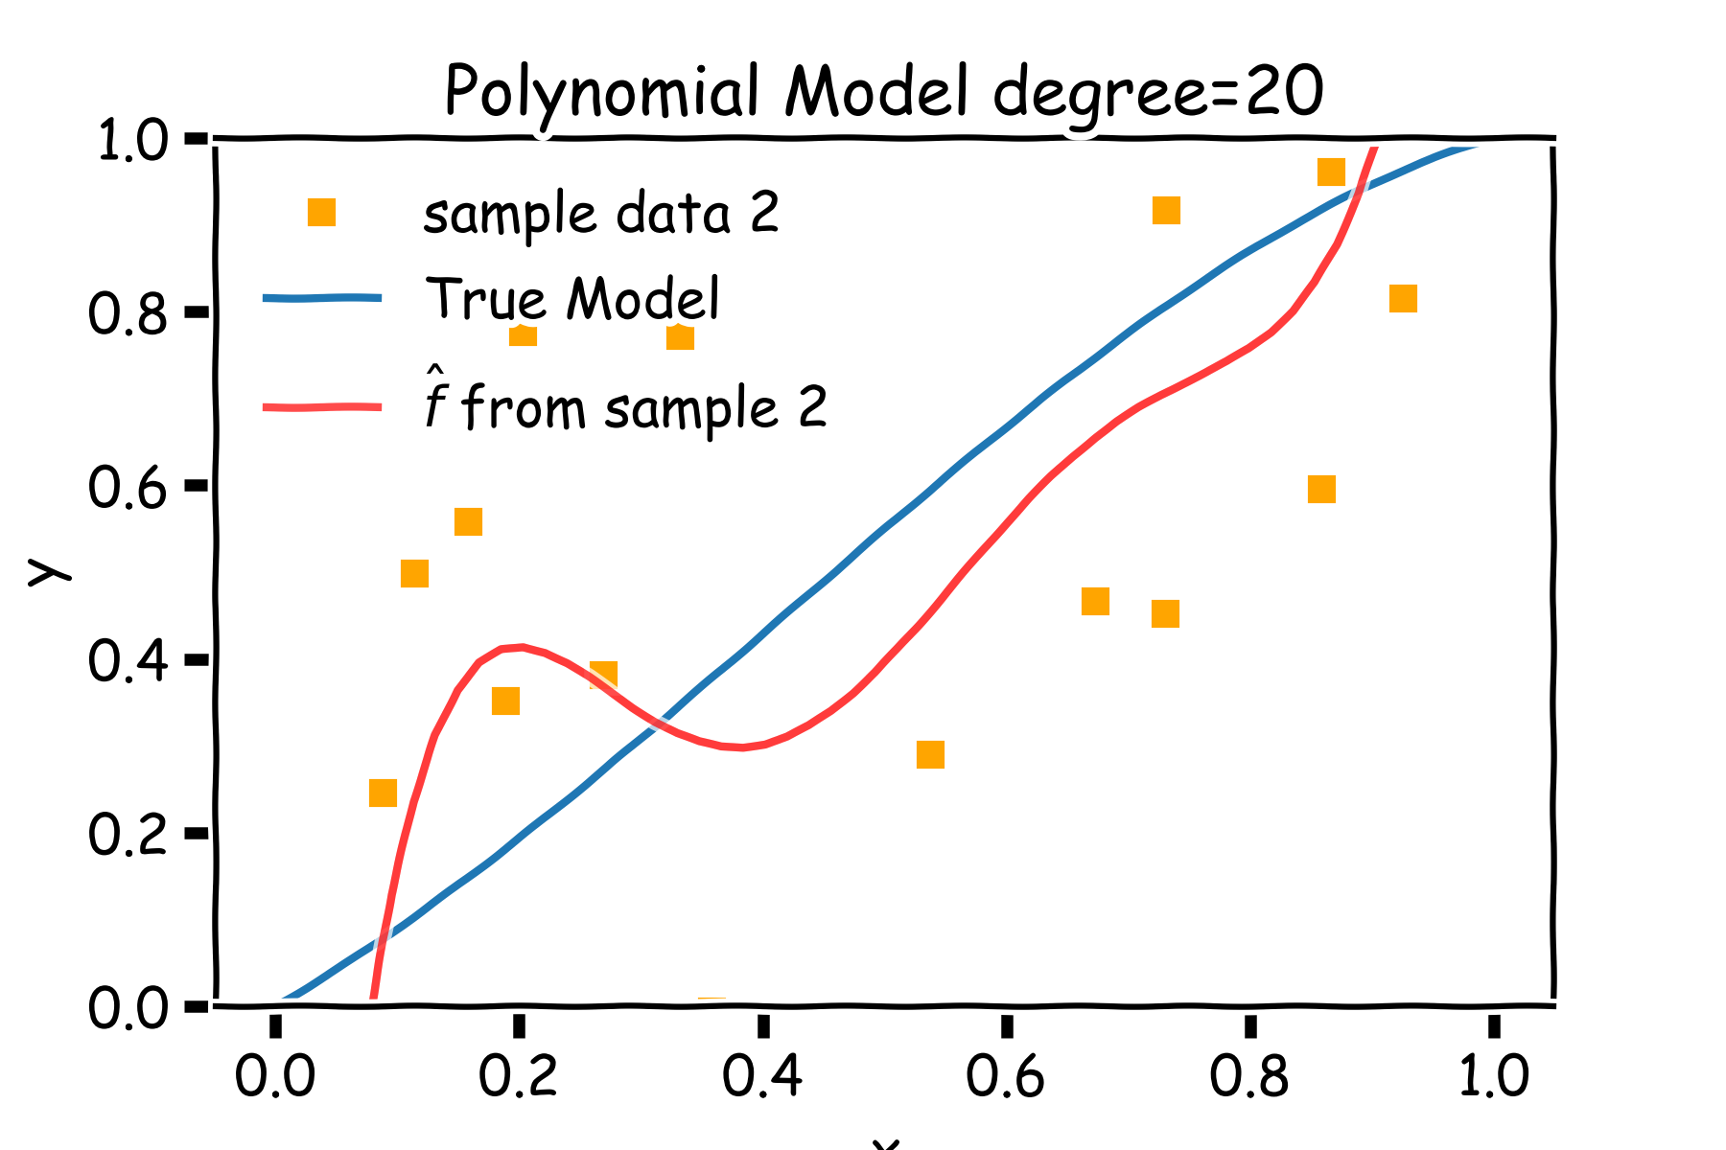
Bias vs Variance

Slide 55

Bias vs Variance

Slide 56

Poly 10 degree models : 20 data points per line 2000 simulations

Slide 57
Bias vs Variance
Left: 2000 best fit straight lines, each fitted on a different 20 point training set.
Right: Best-fit models using degree 10 polynomial

Slide 58

Regularization: An Overview
The idea of regularization revolves around modifying the loss function L; in particular, we add a regularization term that penalizes some specified properties of the model parameters
where $λ$ is a scalar that gives the weight (or importance) of the regularization term.
Fitting the model using the modified loss function L_{reg} would result in model parameters with desirable properties (specified by R).

Slide 59
LASSO Regression
Since we wish to discourage extreme values in model parameter, we need to choose a regularization term that penalizes parameter magnitudes. For our loss function, we will again use MSE.
Together our regularized loss function is:
Note that is the l₁ norm of the vector β

Slide 60
Ridge Regression
Alternatively, we can choose a regularization term that penalizes the squares of the parameter magnitudes. Then, our regularized loss function is:
Note that is the l₂ norm of the vector β

Slide 61

Ridge regularization with validation only: step by step

Slide 62

Ridge regularization with validation only: step by step

Slide 63
Uncertainty in model and prediction
Cross validation
Overfitting: Variance & Bias
Pandas
NumPy
Scikit-Learn
PCA & dimensionality reduction
Statistical Learning
Computing Tools
Matplotlib
Methods of regularization:
Lasso and Ridge
Regression
Classification
Logistic
Linear
Trees
KNN
Neural Networks
Experimental Design & Causal Inference

Slide 64
Uncertainty in model and prediction
Cross validation
Overfitting: Variance & Bias
Pandas
NumPy
Scikit-Learn
PCA & dimensionality reduction
Statistical Learning
Computing Tools
Matplotlib
Methods of regularization:
Lasso and Ridge
Regression
Classification
Logistic
Linear
Trees
KNN
Neural Networks
Experimental Design & Causal Inference

Slide 65

The Intuition Behind PCA
Top PCA components capture the most of amount of variation (interesting features) of the data.
Each component is a linear combination of the original predictors - we visualize them as vectors in the feature space.

Slide 66

The Intuition Behind PCA (cont.)
Transforming our observed data means projecting our dataset onto the space defined by the top m PCA components, these components are our new predictors.

Slide 67
A Framework For Dimensionality Reduction
One way to reduce the dimensions of the feature space is to create a new, smaller set of predictors by taking linear combinations of the original predictors.
We choose Z₁, Z₂,…, Z_{m}, where $m≤p$ and where each Z_{i} is a linear combination of the original p predictors
$$Z_{i}=\sum_{j=1}^{p}{φ_{ji}X_{j}}$$
for fixed constants $φ_{ji}$. Then we can build a linear regression regression model using the new predictors
$$Y=β_{0}+β_{1}Z_{1}+…+β_{m}Z_{m}+ε$$
Notice that this model has a smaller number (m+1 < p+1) of parameters.

Slide 68


The Math behind PCA
PCA is a well-known result from linear algebra. Let Z be the n x p matrix consisting of columns Z₁,…, Z_{p} (the resulting PCA vectors), X be the n x p matrix of X₁,…, X_{p} of the original data variables (each standardized to have mean zero and variance one, and without the intercept), and let W be the p x p matrix whose columns are the eigenvectors of the square matrix X$T$X, then:

Slide 69
Uncertainty in model and prediction
Cross validation
Overfitting: Variance & Bias
Pandas
NumPy
Scikit-Learn
PCA & dimensionality reduction
Statistical Learning
Computing Tools
Matplotlib
Methods of regularization:
Lasso and Ridge
Regression
Classification
Logistic
Linear
Trees
KNN
Neural Networks
Experimental Design & Causal Inference

Slide 70
Uncertainty in model and prediction
Cross validation
Overfitting: Variance & Bias
Pandas
NumPy
Scikit-Learn
PCA & dimensionality reduction
Statistical Learning
Computing Tools
Matplotlib
Methods of regularization:
Lasso and Ridge
Regression
Classification
Logistic
Linear
Trees
KNN
Neural Networks
Experimental Design & Causal Inference

Slide 71
Uncertainty in model and prediction
Cross validation
Overfitting: Variance & Bias
Pandas
NumPy
Scikit-Learn
PCA & dimensionality reduction
Statistical Learning
Computing Tools
Matplotlib
Methods of regularization:
Lasso and Ridge
Regression
Classification
Logistic
Linear
Trees
KNN
Neural Networks
Experimental Design & Causal Inference

Slide 72
Uncertainty in model and prediction
Cross validation
Overfitting: Variance & Bias
Pandas
NumPy
Scikit-Learn
PCA & dimensionality reduction
Statistical Learning
Computing Tools
Matplotlib
Methods of regularization:
Lasso and Ridge
Regression
Classification
Logistic
Linear
Trees
KNN
Neural Networks
Experimental Design & Causal Inference

Slide 73

Even Simpler Classification Problem: Binary Response (cont)
What could go wrong with this linear regression model?
.

Slide 74



Pavlos Game #45
Think of a function that would do this for us
$$Y=f(x)$$

Slide 75




Logistic Regression
$$2β_{1}$$
$$−\frac{β_{0}}{β_{1}}$$
$$\frac{β_{1}}{4}$$

Slide 76


Estimation in Logistic Regression
Probability $Y=1: p$
Probability $Y=0: 1−p$
$${P\left(Y=y\right)=p}^{y}{(1−p)}^{(1−y)}$$
where:
$p=P(Y=1|X=x)$ and therefore p depends on X.
Thus not every p is the same for each individual measurement.

Slide 77


Likelihood
The likelihood of a single observation for p given x and y is:
Given the observations are independent, what is the likelihood function for p?
$$L\left(p_{i} | Y_{i}\right)=P\left(Y_{i}=y_{i}\right)=p_{i}^{y_{i}}{\left(1−p_{i}\right)}^{1−y_{i}}$$
$$L\left(p | Y\right)=\prod_{i}{P\left(Y_{i}=y_{i}\right)=\prod_{i}{p_{i}^{y_{i}}{\left(1−p_{i}\right)}^{1−y_{i}}}}$$
$$l\left(p | Y\right)=−\log{L\left(p | Y\right)=}−\sum_{i}{y_{i}\log{p_{i}+\left(1−y_{i}\right)\log{(1−p_{i})}}}$$

Slide 78

Loss Function
$$l\left(p | Y\right)=−\sum_{i}{{\left\lfloor y_{i}\log{\frac{1}{1+e^{−βX_{i}}}+\left(1−y_{i}\right)\log\left(1−\frac{1}{1+e^{−βX_{i}}}\right)}\right\rfloor }_{i} }$$
How do we minimize this?
Differentiate, equate to zero and solve for it!
But jeeze does this look messy?! It will not necessarily have a closed form solution.
So how do we determine the parameter estimates? Through an iterative approach (we will talk about this at length in future lectures).

Slide 79

Classifier with two predictors
How can we estimate a classifier, based on logistic regression, for the following plot?

Slide 80

Multiple Logistic Regression
Earlier we saw the general form of simple logistic regression, meaning when there is just one predictor used in the model. What was the model statement (in terms of linear predictors)?
Multiple logistic regression is a generalization to multiple predictors. More specifically we can define a multiple logistic regression model to predict $P(Y=1)$ as such:

Slide 81
Uncertainty in model and prediction
Cross validation
Overfitting: Variance & Bias
Pandas
NumPy
Scikit-Learn
PCA & dimensionality reduction
Statistical Learning
Computing Tools
Matplotlib
Methods of regularization:
Lasso and Ridge
Regression
Classification
Logistic
Linear
Trees
KNN
Neural Networks
Experimental Design & Causal Inference

Slide 82
Uncertainty in model and prediction
Cross validation
Overfitting: Variance & Bias
Pandas
NumPy
Scikit-Learn
PCA & dimensionality reduction
Statistical Learning
Computing Tools
Matplotlib
Methods of regularization:
Lasso and Ridge
Regression
Classification
Logistic
Linear
Trees
KNN
Neural Networks
Experimental Design & Causal Inference

Slide 83
Uncertainty in model and prediction
Cross validation
Overfitting: Variance & Bias
Pandas
NumPy
Scikit-Learn
PCA & dimensionality reduction
Statistical Learning
Computing Tools
Matplotlib
Methods of regularization:
Lasso and Ridge
Regression
Classification
Logistic
Linear
Trees
KNN
Neural Networks
Experimental Design & Causal Inference

Slide 84


Slide 85
Uncertainty in model and prediction
Cross validation
Overfitting: Variance & Bias
Pandas
NumPy
Scikit-Learn
PCA & dimensionality reduction
Statistical Learning
Computing Tools
Matplotlib
Methods of regularization:
Lasso and Ridge
Regression
Classification
Logistic
Linear
Trees
KNN
Neural Networks
Experimental Design & Causal Inference

Slide 86
Uncertainty in model and prediction
Cross validation
Overfitting: Variance & Bias
Pandas
NumPy
Scikit-Learn
PCA & dimensionality reduction
Statistical Learning
Computing Tools
Matplotlib
Methods of regularization:
Lasso and Ridge
Regression
Classification
Logistic
Linear
Trees
KNN
Neural Networks
Experimental Design & Causal Inference

Slide 87


Slide 88
Uncertainty in model and prediction
Cross validation
Overfitting: Variance & Bias
Pandas
NumPy
Scikit-Learn
PCA & dimensionality reduction
Statistical Learning
Computing Tools
Matplotlib
Methods of regularization:
Lasso and Ridge
Regression
Classification
Logistic
Linear
Trees
KNN
Neural Networks
Experimental Design & Causal Inference

Slide 89
Uncertainty in model and prediction
Cross validation
Overfitting: Variance & Bias
Pandas
NumPy
Scikit-Learn
PCA & dimensionality reduction
Statistical Learning
Computing Tools
Matplotlib
Methods of regularization:
Lasso and Ridge
Regression
Classification
Logistic
Linear
Trees
KNN
Neural Networks
Experimental Design & Causal Inference

Slide 90


Slide 91
Uncertainty in model and prediction
Cross validation
Overfitting: Variance & Bias
Pandas
NumPy
Scikit-Learn
PCA & dimensionality reduction
Statistical Learning
Computing Tools
Matplotlib
Methods of regularization:
Lasso and Ridge
Regression
Classification
Logistic
Linear
Trees
KNN
Neural Networks
Experimental Design & Causal Inference

Slide 92
Uncertainty in model and prediction
Cross validation
Overfitting: Variance & Bias
Pandas
NumPy
Scikit-Learn
PCA & dimensionality reduction
Statistical Learning
Computing Tools
Matplotlib
Methods of regularization:
Lasso and Ridge
Regression
Classification
Logistic
Linear
Trees
KNN
Neural Networks
Experimental Design & Causal Inference

Slide 93


Slide 94
Uncertainty in model and prediction
Cross validation
Overfitting: Variance & Bias
Pandas
NumPy
Scikit-Learn
PCA & dimensionality reduction
Statistical Learning
Computing Tools
Matplotlib
Methods of regularization:
Lasso and Ridge
Regression
Classification
Logistic
Linear
Trees
KNN
Neural Networks
Experimental Design & Causal Inference

Slide 95
Uncertainty in model and prediction
Cross validation
Overfitting: Variance & Bias
Pandas
NumPy
Scikit-Learn
PCA & dimensionality reduction
Statistical Learning
Computing Tools
Matplotlib
Methods of regularization:
Lasso and Ridge
Regression
Classification
Logistic
Linear
Trees
KNN
Neural Networks
Experimental Design & Causal Inference

Slide 96

The Geometry of Flow Charts
Each comparison and branching represents splitting a region in the feature space on a single feature. Typically, at each iteration, we split once along one dimension (one predictor). Why?

Slide 97

Combine them? 2 magic realisms

Slide 98

Combine them? 20 magic realisms

Slide 99

Combine them? 100 magic realisms

Slide 100


Improving on Bagging
Recall, for $B$ number of identically and independently distributed variable, X, with variance $σ^{2}$, the variance of the estimate of the mean is :
$$var\left({\hat{μ}}_{x}\right)=\frac{σ^{2}}{B}$$

Slide 101


Improving on Bagging
For $B$ number of identically but not independently distributed variables with pairwise correlation $ρ$ and variance $σ^{2}$, the variance of their mean is
$$var\left({\hat{μ}}_{x}\right)∝σ^{2}(1+ρ^{2})/B$$

Slide 102

Random Forests
Random Forest is a modified form of bagging that creates ensembles of independent decision trees.
To de-correlate the trees, we:
train each tree on a separate bootstrap sample of the full training set (same as in bagging)
for each tree, at each split, we randomly select a set of $J′$ predictors from the full set of predictors.
From amongst the $J′$ predictors, we select the optimal predictor and the optimal corresponding threshold for the split.

Slide 103

Gradient Boosting: illustration

Slide 104

Gradient Boosting: illustration

Slide 105

Gradient Boosting: illustration

Slide 106

Gradient Boosting: illustration

Slide 107

Gradient Boosting: illustration

Slide 108

Gradient Boosting: illustration

Slide 109

Gradient Boosting: illustration

Slide 110

Gradient Boosting: illustration

Slide 111
Uncertainty in model and prediction
Cross validation
Overfitting: Variance & Bias
Pandas
NumPy
Scikit-Learn
PCA & dimensionality reduction
Statistical Learning
Computing Tools
Matplotlib
Methods of regularization:
Lasso and Ridge
Regression
Classification
Logistic
Linear
Trees
KNN
Neural Networks
Experimental Design & Causal Inference

Slide 112
Uncertainty in model and prediction
Cross validation
Overfitting: Variance & Bias
Pandas
NumPy
Scikit-Learn
PCA & dimensionality reduction
Statistical Learning
Computing Tools
Matplotlib
Methods of regularization:
Lasso and Ridge
Regression
Classification
Logistic
Linear
Trees
KNN
Neural Networks
Experimental Design & Causal Inference

Slide 113
Build our first ANN
Affine
Activation
Loss Fun
$$ℒ(W)=\sum_{i}^{n}{ℒ_{i}\left(W\right)}$$
$$\hat{y}=\frac{1}{1+e^{−h}}$$
$$X$$
$$h=XW$$
“Sigmoid activation” $σ$
$$X$$
$σ$(XW)
$$Y$$
Single Neuron Network
Very similar to Perceptron

Slide 114

Combining neurons allows us to model interesting functions
X
Y

Slide 115

Different weights change the shape and position
X
Y

Slide 116

Neural networks can model any reasonable function
X
Y

Slide 117

Adding layers allows us to model increasingly complex functions
X
Y

Slide 118
Anatomy of artificial neural network (ANN)
input layer
output layer
hidden layer 1
hidden layer 2

Slide 119

Learning Multiple Components

Slide 120













Depth = Repeated Compositions

Slide 121



Gradient Descent (cont.)
If the step is proportional to the slope then you avoid overshooting the minimum. How?
$$\frac{dℒ(W)}{dW}$$
$$\frac{dℒ(W)}{dW}$$
$$\frac{dℒ(W)}{dW}$$

Slide 122

Data Augmentation

Slide 123

Dropout
Randomly set some neurons and their connections to zero (i.e. “dropped”)
Prevent overfitting by reducing co-adaptation of neurons
Like training many random sub-networks

Slide 124

Dropout
Widely used and highly effective
Proposed as an alternative to ensembling, which is too expensive for neural nets
Test error for different architectures with and without dropout. The networks have 2 to 4 hidden layers each with 1024 to 2048 units.
http://jmlr.org/papers/volume15/srivastava14a/srivastava14a.pdf

Slide 125
Uncertainty in model and prediction
Cross validation
Overfitting: Variance & Bias
Pandas
NumPy
MEMES
Scikit-Learn
PCA & dimensionality reduction
Statistical Learning
Computing Tools
Matplotlib
Methods of regularization:
Lasso and Ridge
Regression
Classification
Logistic
Linear
Trees
KNN
Neural Networks
Experimental Design & Causal Inference

Slide 126

Summary from last lecture

Slide 127

Confidence intervals for the predictors estimates (cont)
So if we just have one set of measurements of $\{X,Y\},$our estimates of ${\hat{β}}_{0}$ and ${\hat{β}}_{1}$ are just for this particular realization.
Notes:
Gabriel García Márquez, whose novel One Hundred Years of Solitude … magic realism.

Slide 128


Slide 129
You’re Gonna Have a Bad Time…

Slide 130

https://twitter.com/wdaali999/status/1161973951565881345

Slide 131
Quiz time: Lecture 8

Slide 132
PPppBoost

Slide 133


Slide 135
Better than AB…

Slide 136


Slide 137

Interpretable Models
People in every walk of life have long been using interpretable models for differentiating between classes of objects and phenomena:

Slide 138


Slide 140


Slide 141


ANNOUNCEMENTS
Homework 7 individual
HW1
HW4
HW7
Without OH or ED forum

Slide 142

ANNOUNCEMENTS
After CS109B, STAT 139 …

Slide 144

Zeenat Potia

Slide 145

Find Me?

Slide 146
CS109B Instructors: Pavlos Protopapas, Mark Glickman, Chris Tanner Topics HW: Similar to 109A Modules Medical School: Mauricio Santillana FAS: Doug Finkbeiner GSD: Garcia del Castillo Lopez HCSPH: Francesca Dominici

Slide 147
Thank You!

